Slide 1


Slide 2
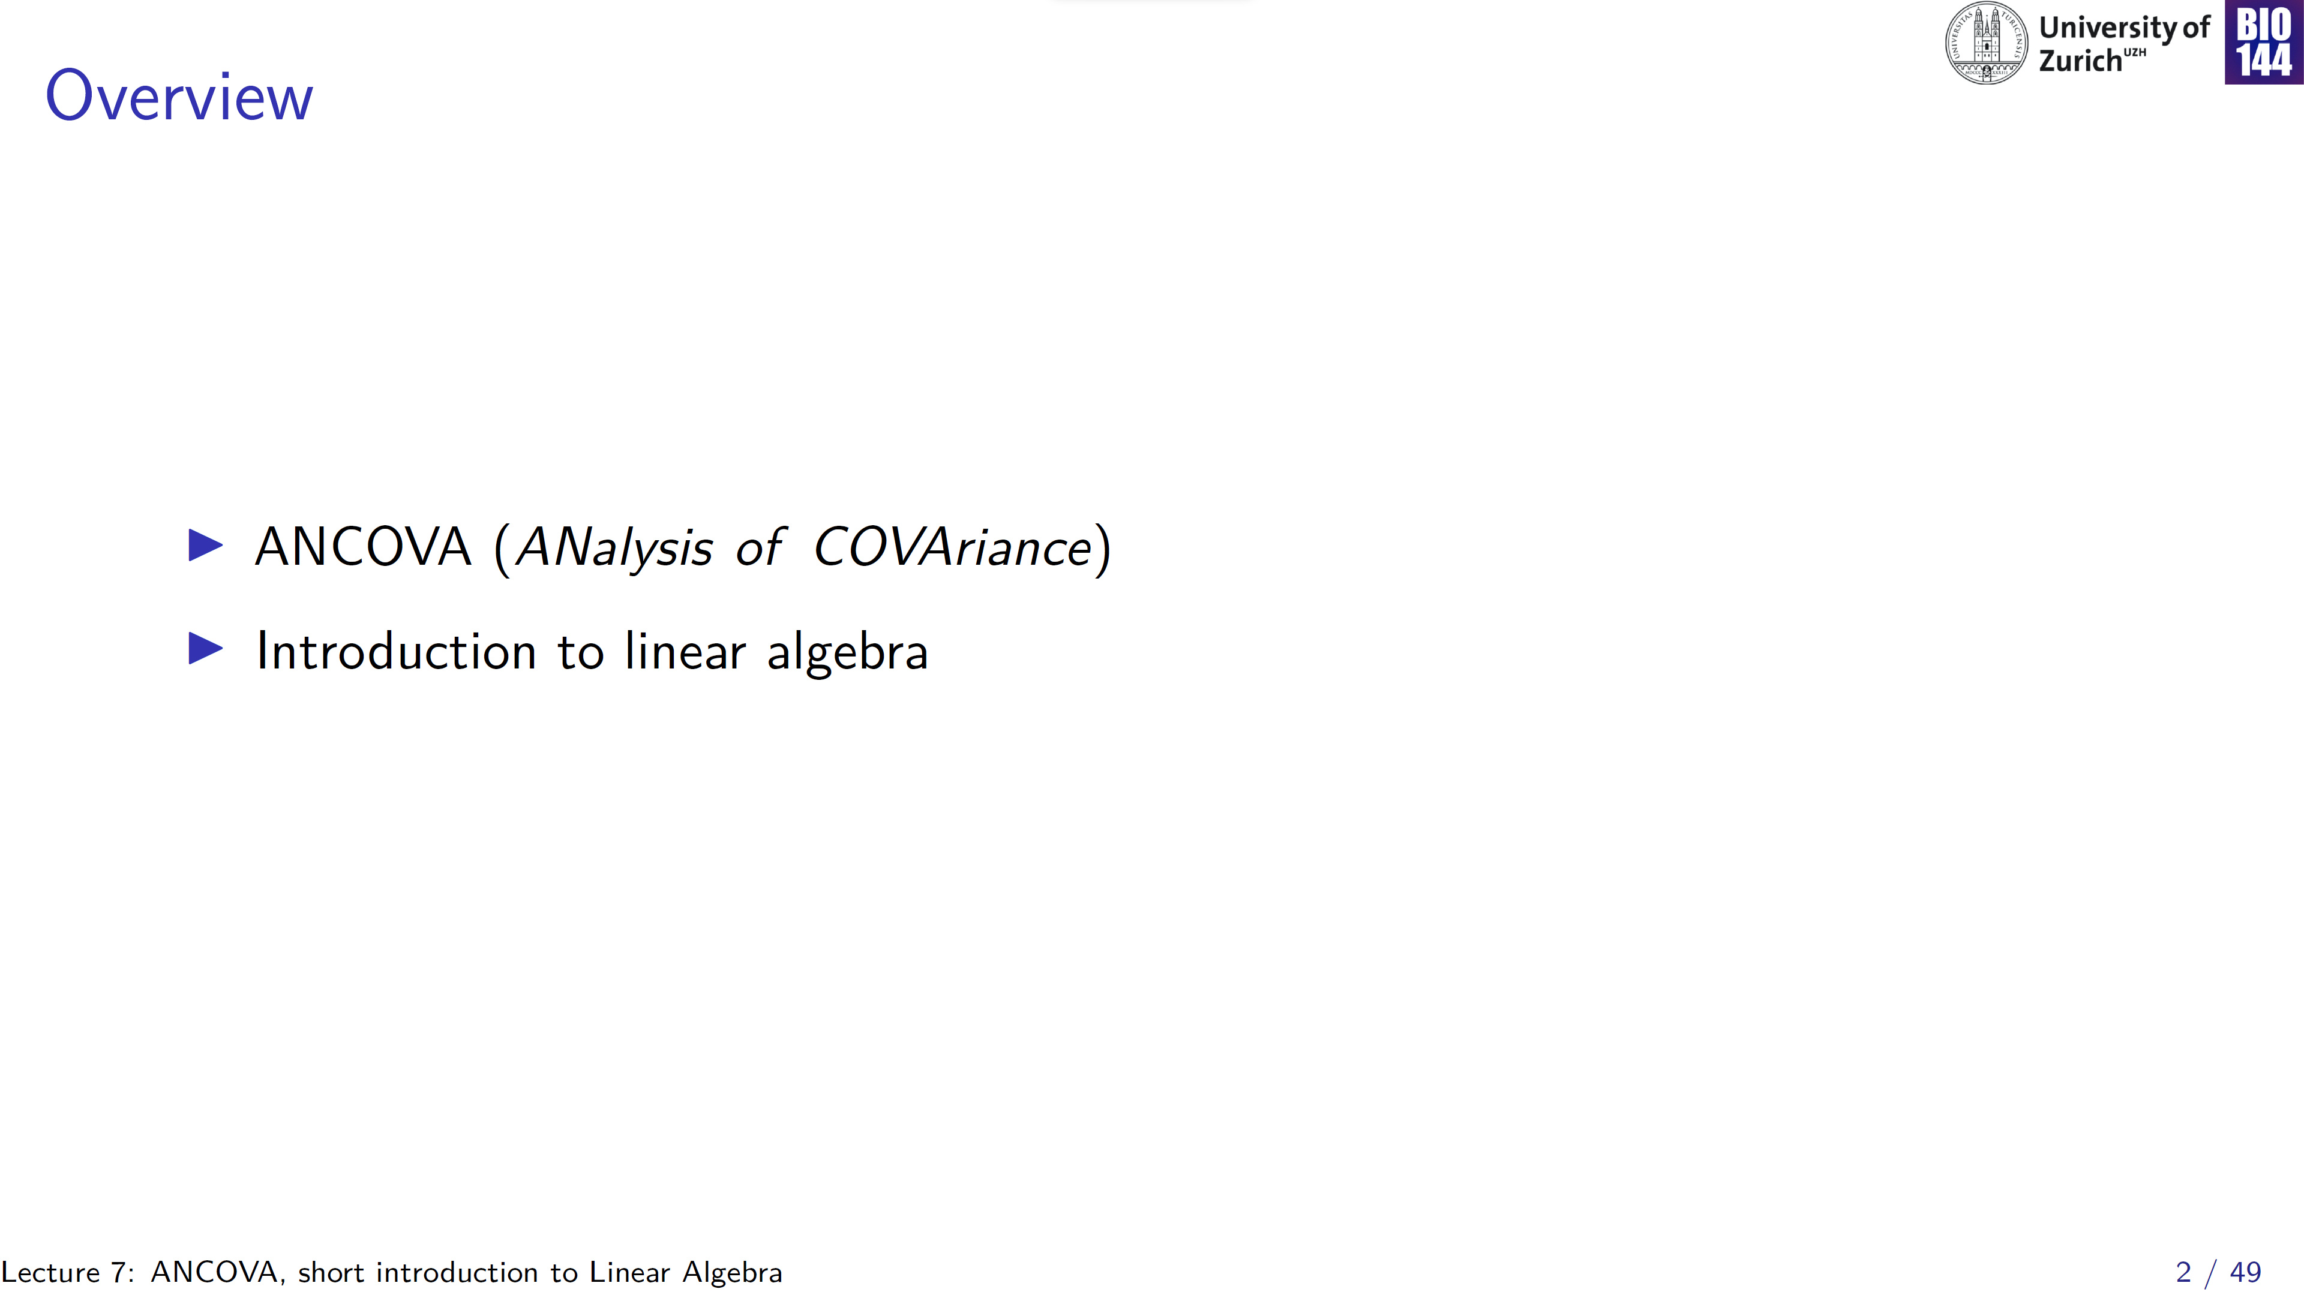

Slide 3
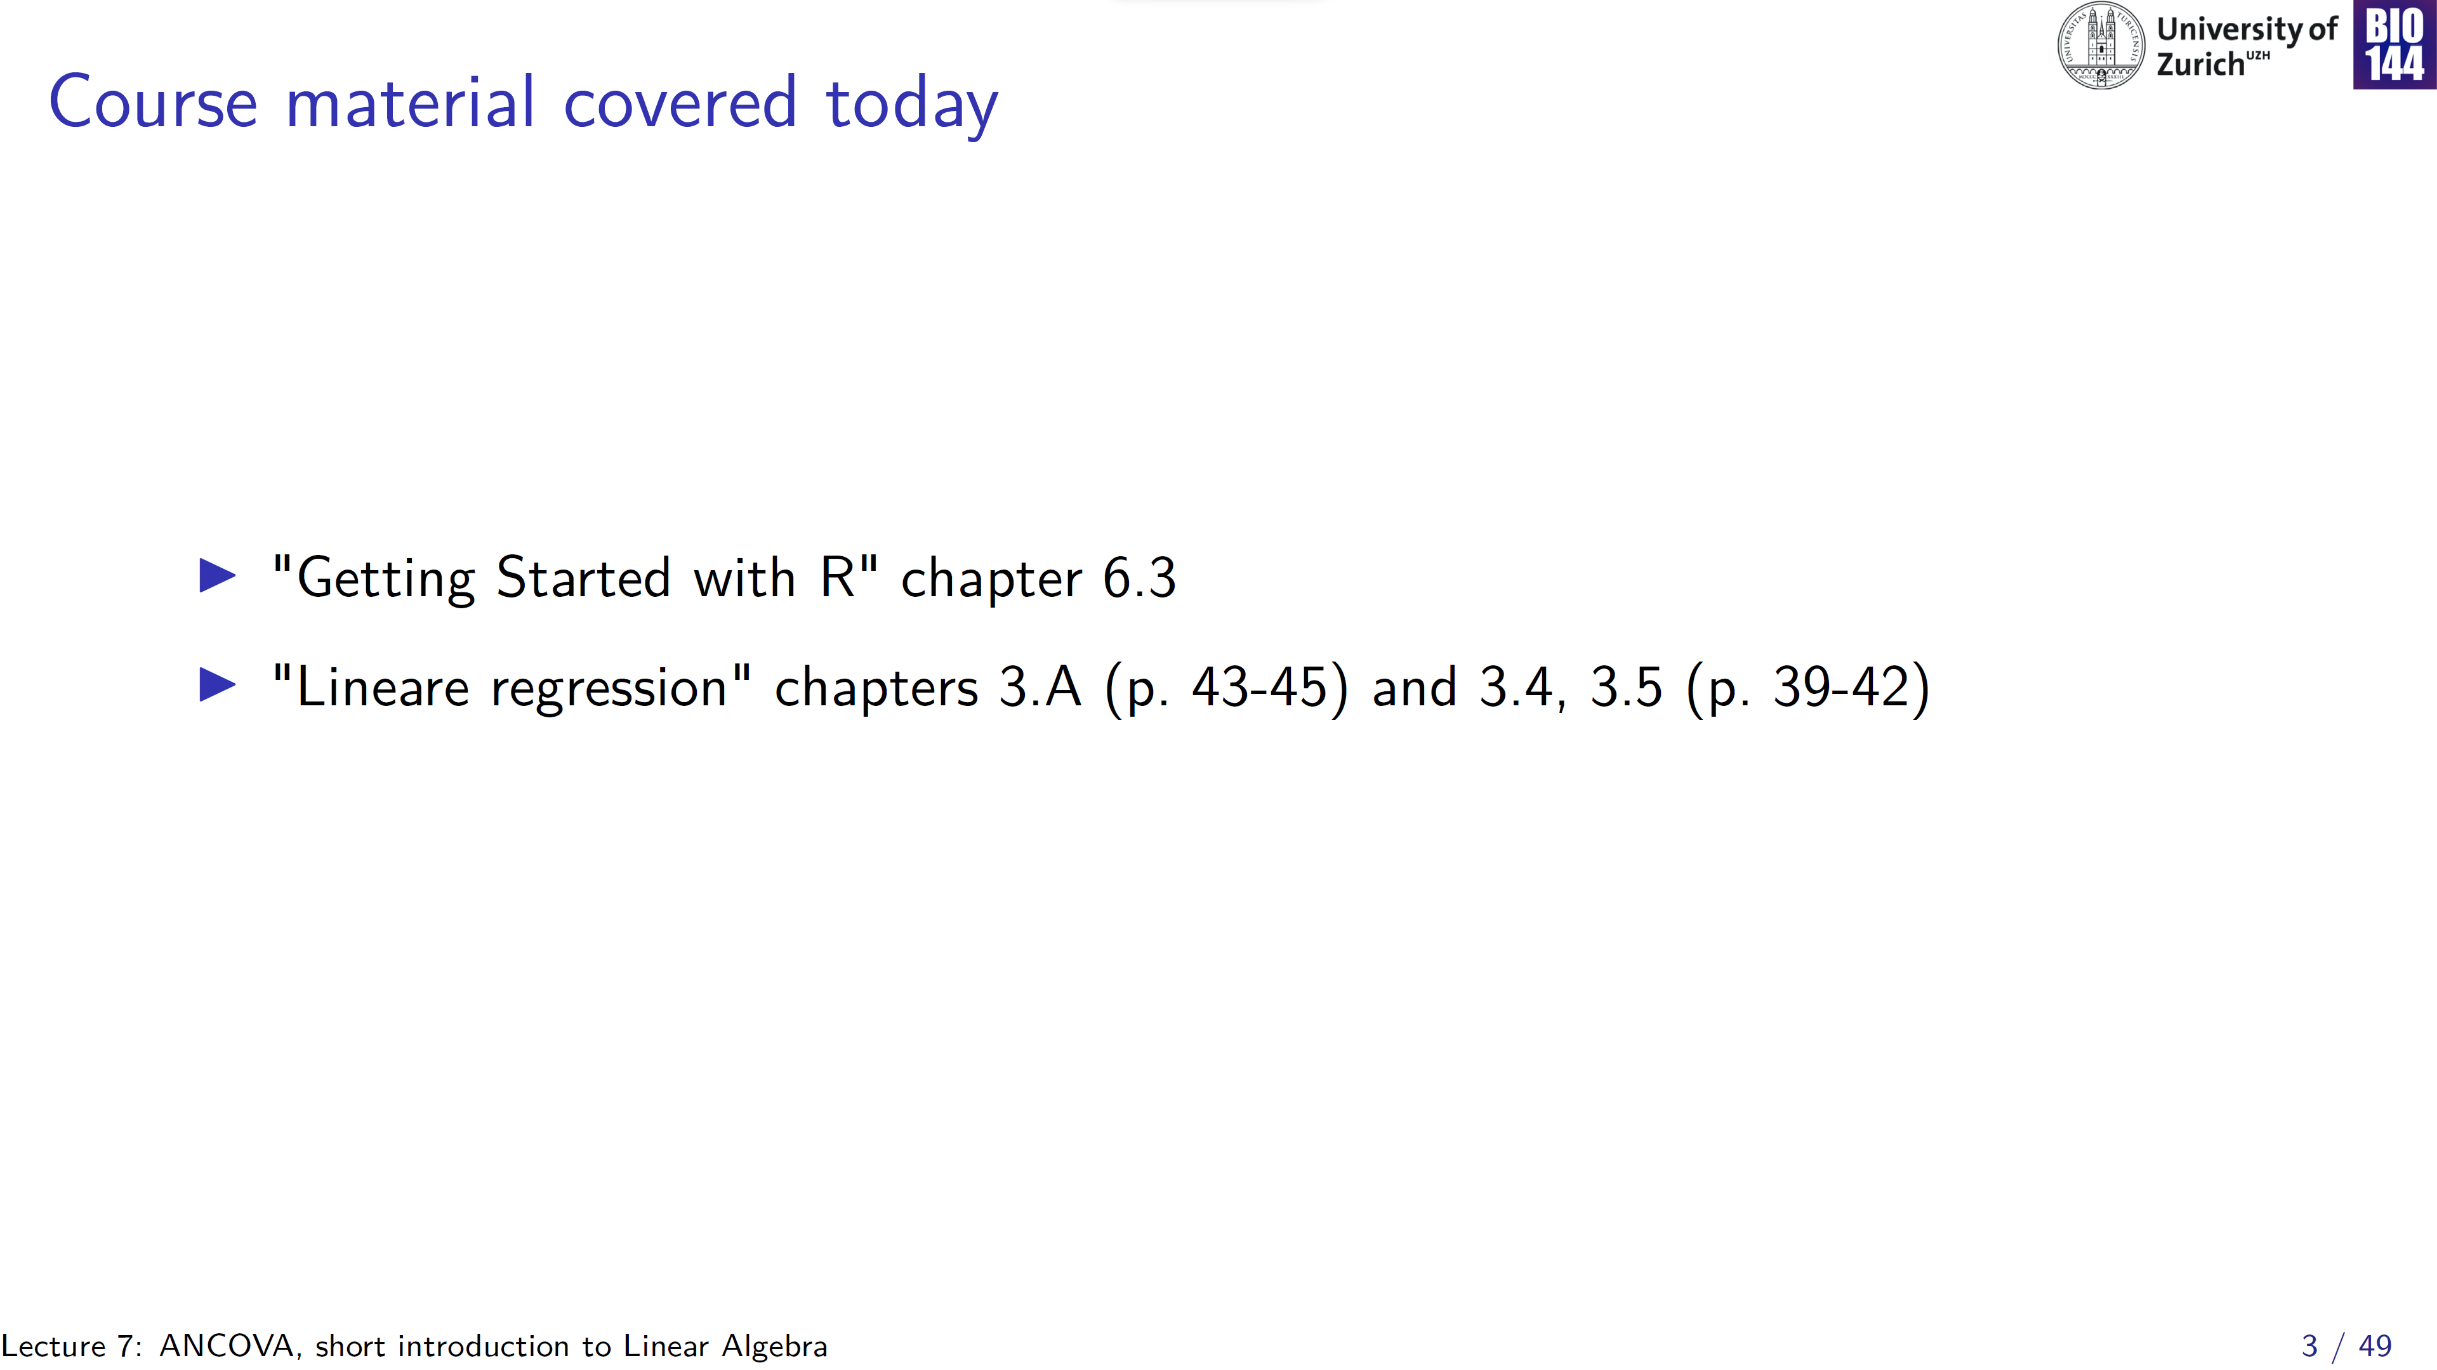
Beckerman and Petchey
Stahel

Slide 4
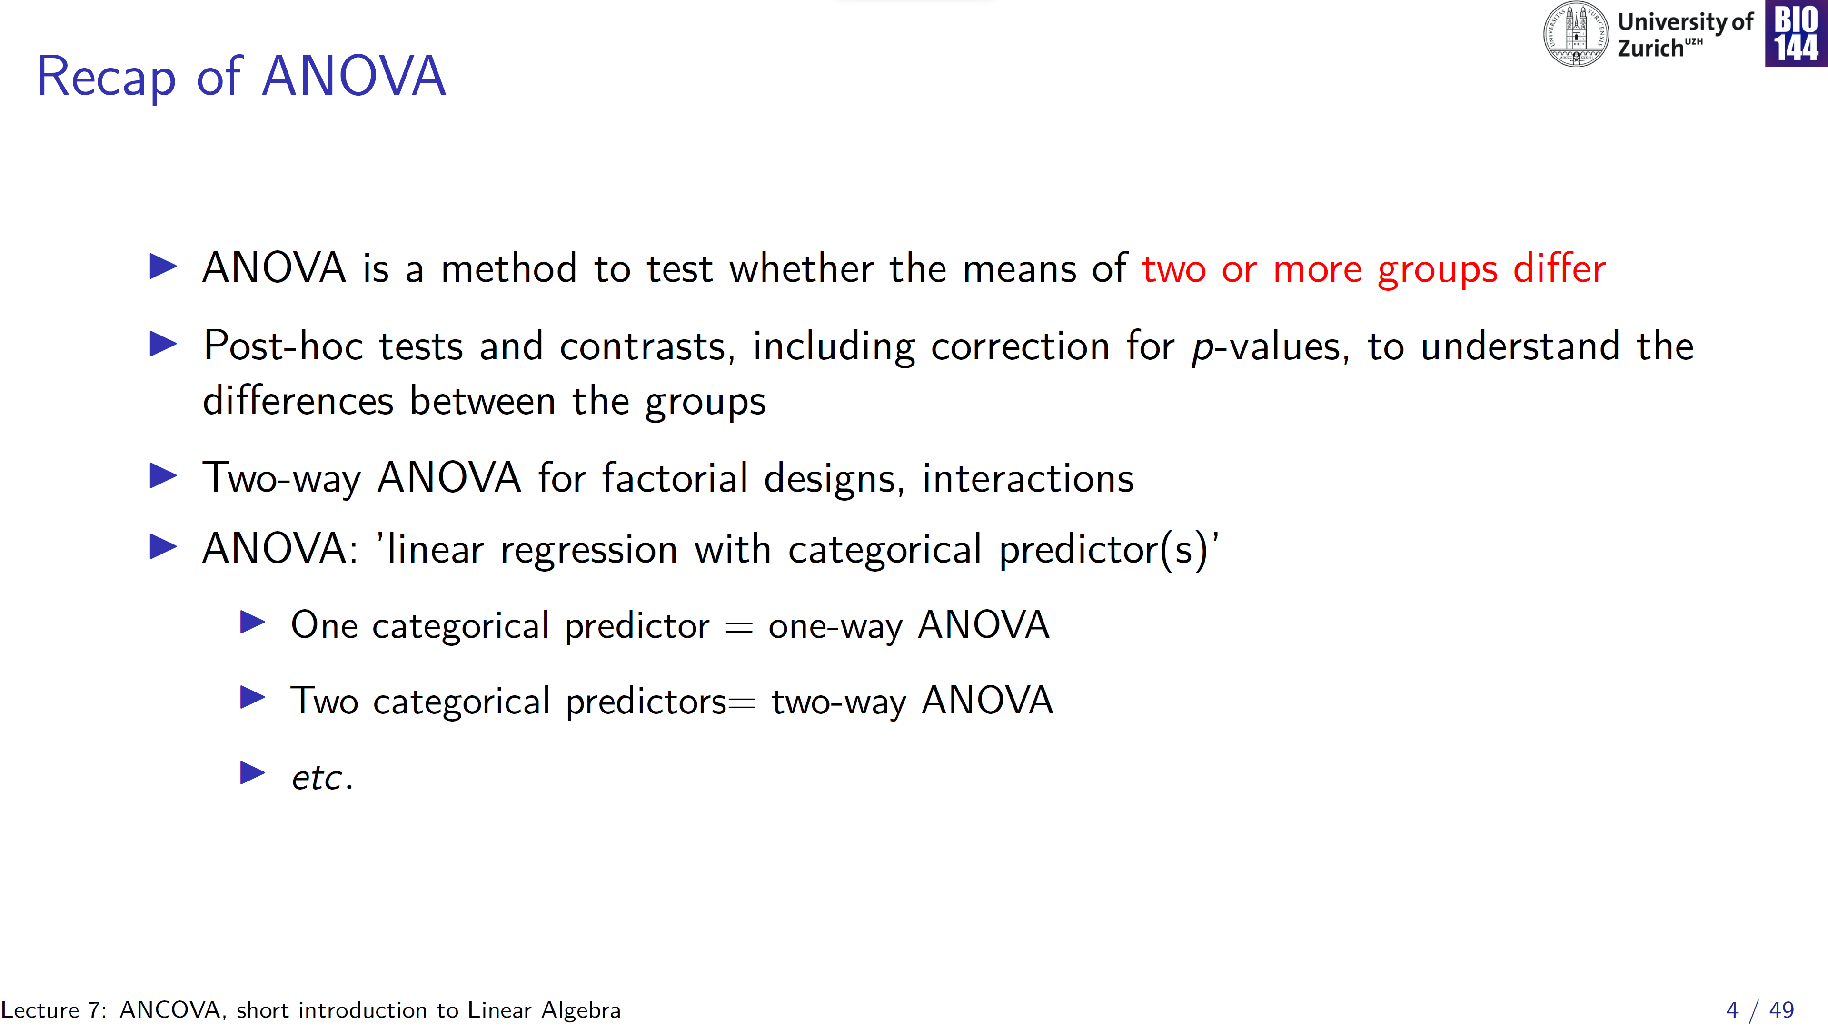

Slide 5
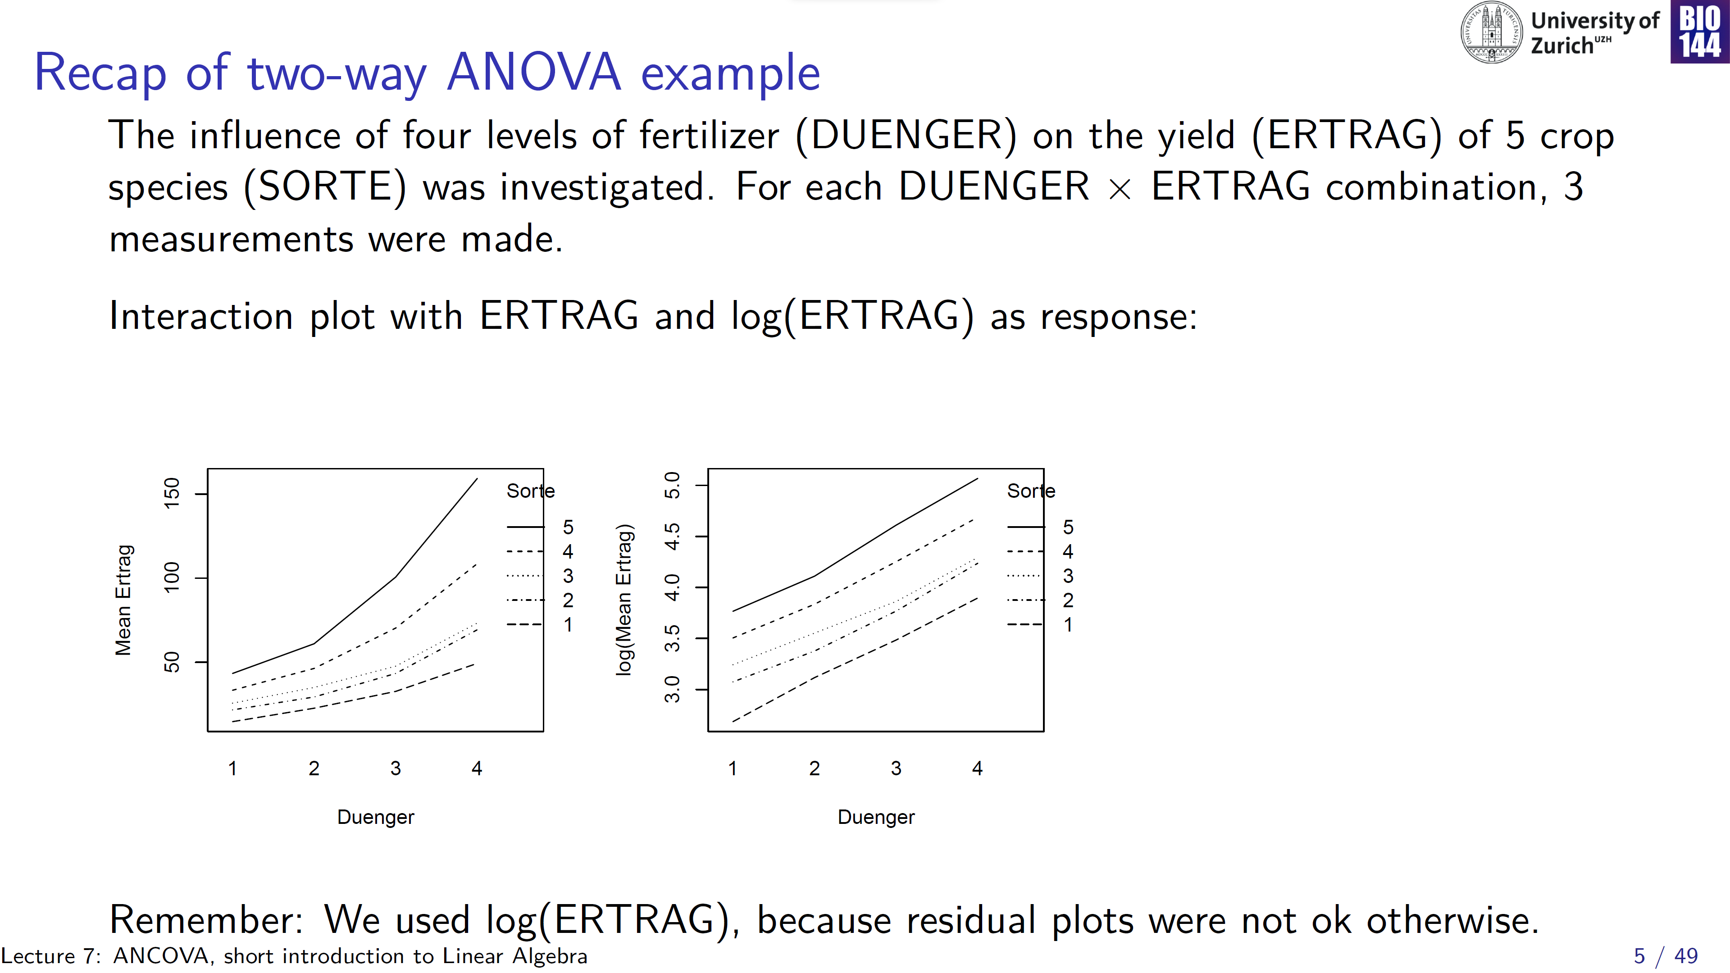
residuals
0
fitted
heteroscedasticity
Notes:
5 species, and 4 different amounts of fertilizer

Slide 6
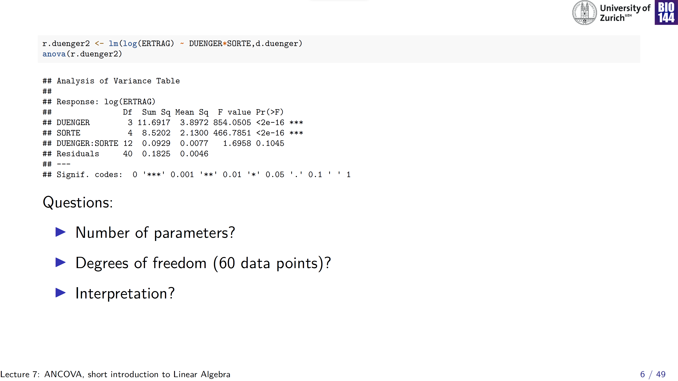
DUENGER: 4 levels – 1 (i.e. the intercept)
SORTE: 5 species – 1 (i.e. the intercept)
For interpretation, read bottom-up:
If interaction is significant, don’t interpret main effects
If interaction is not significant, it can be dropped
59 + 1 for the intercept= 60
Interaction could be dropped from the model, but it seems both DUENGER and SORTE have an effect on log(ERTRAG)
→ see summary for direction and magnitude of these effects

Slide 7
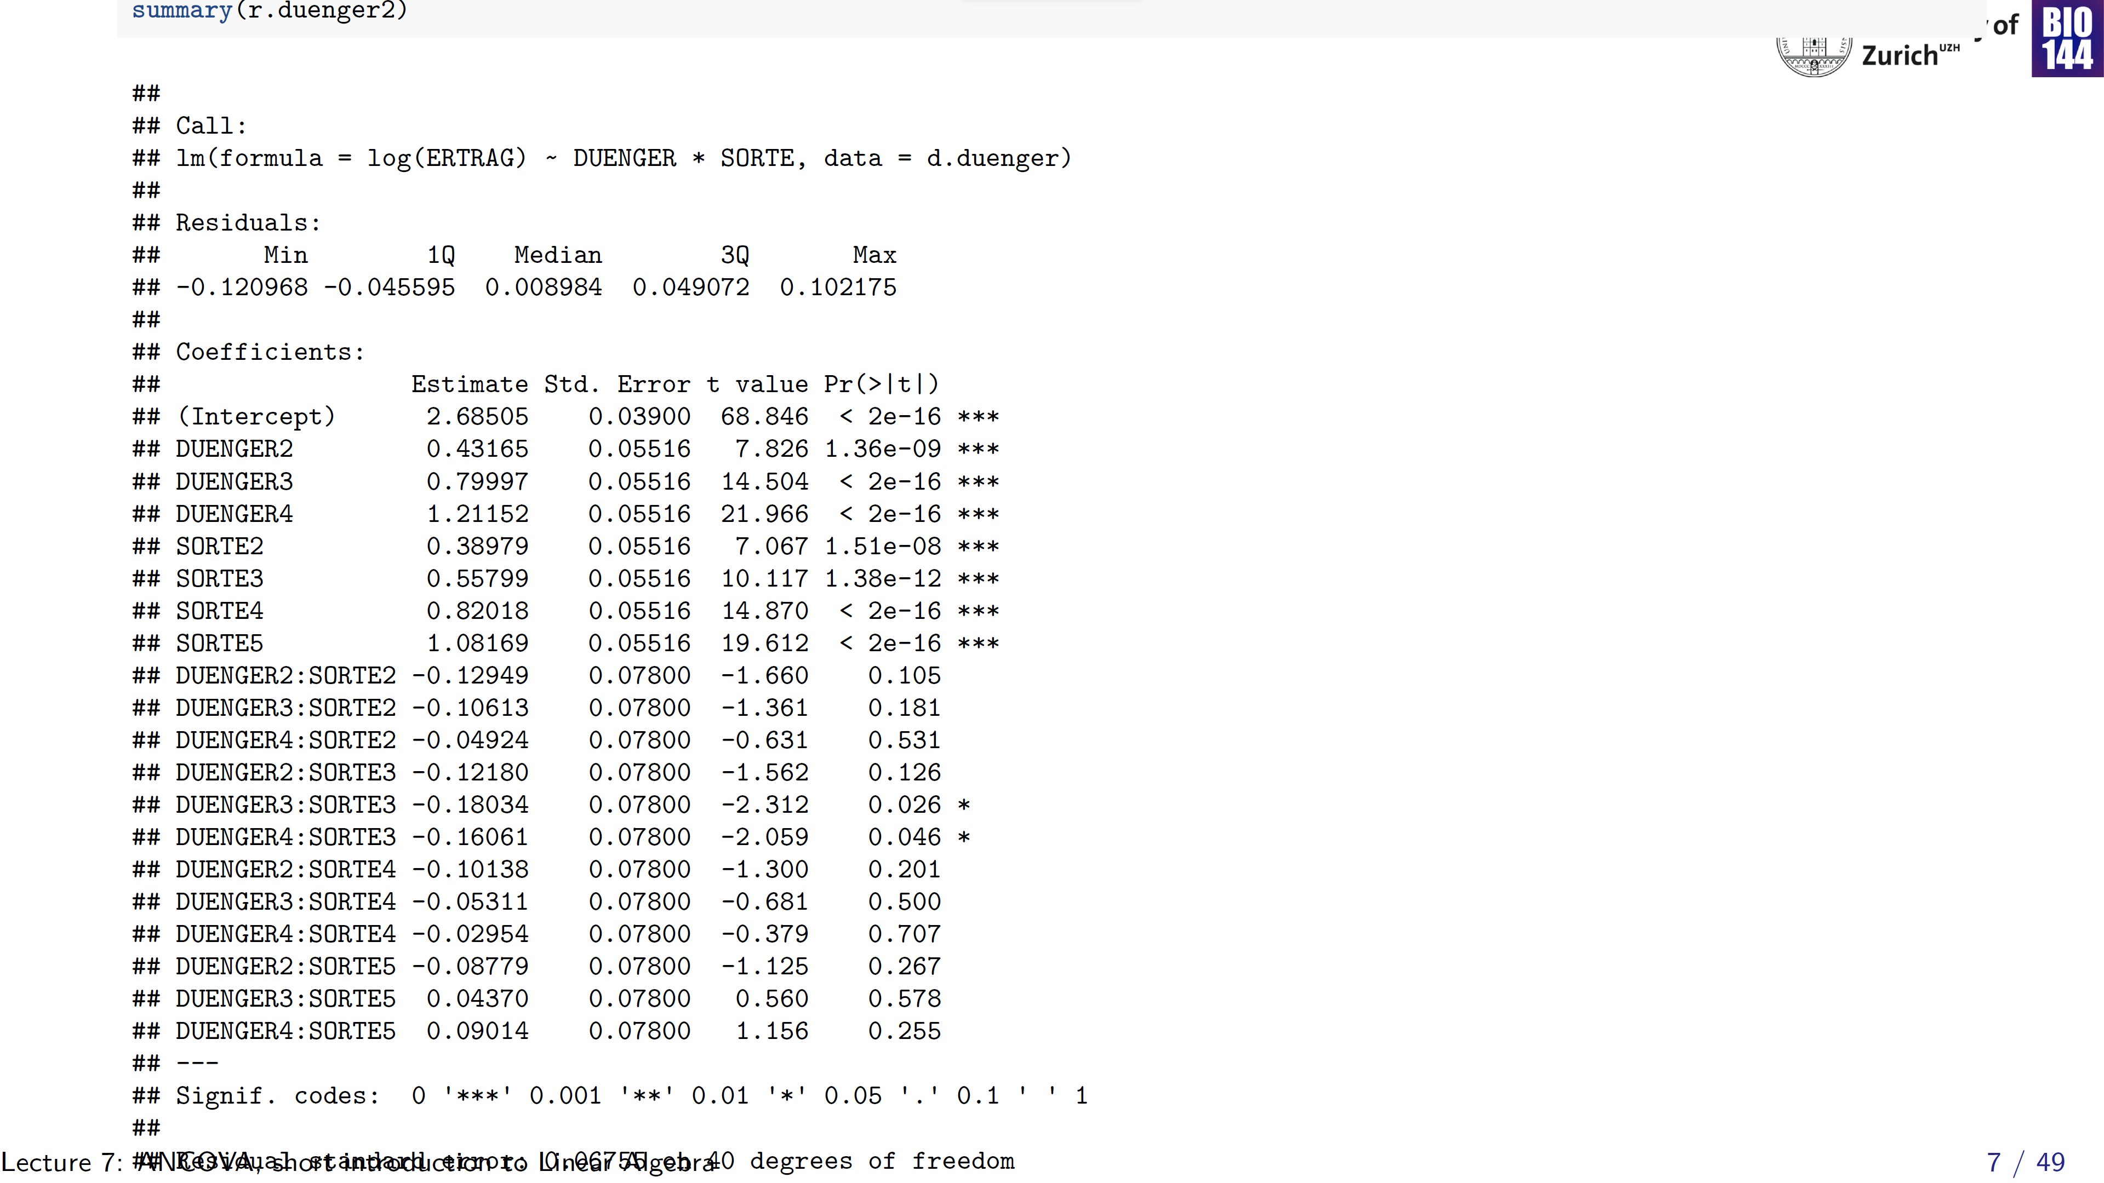
Notes:
Strike out the interaction terms

Slide 8
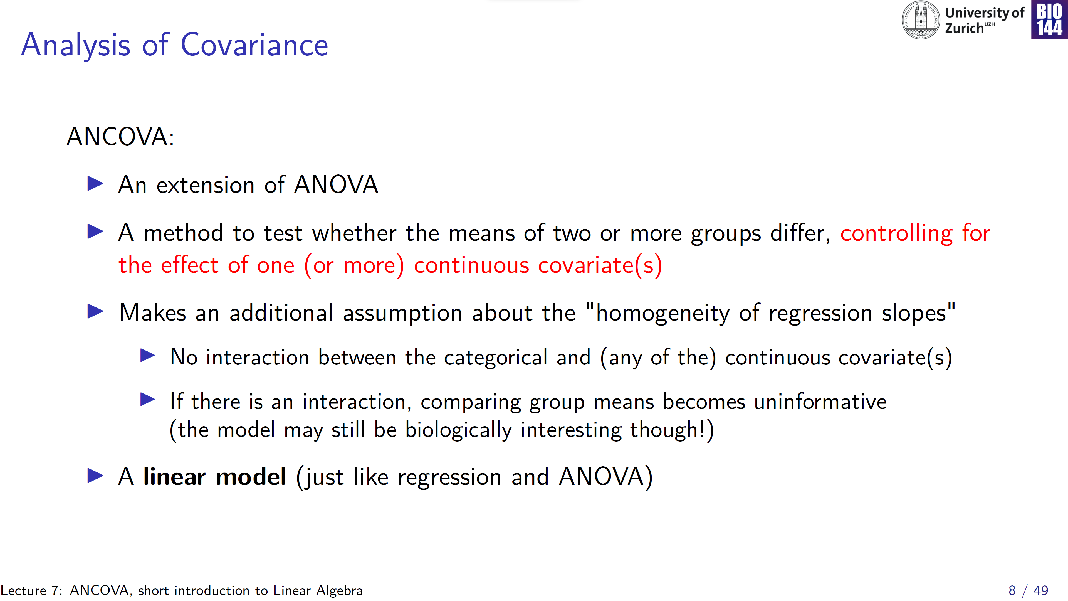

Slide 9
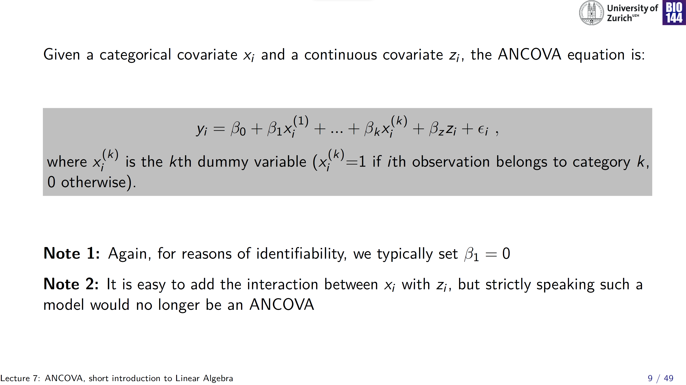
intercept

Slide 10
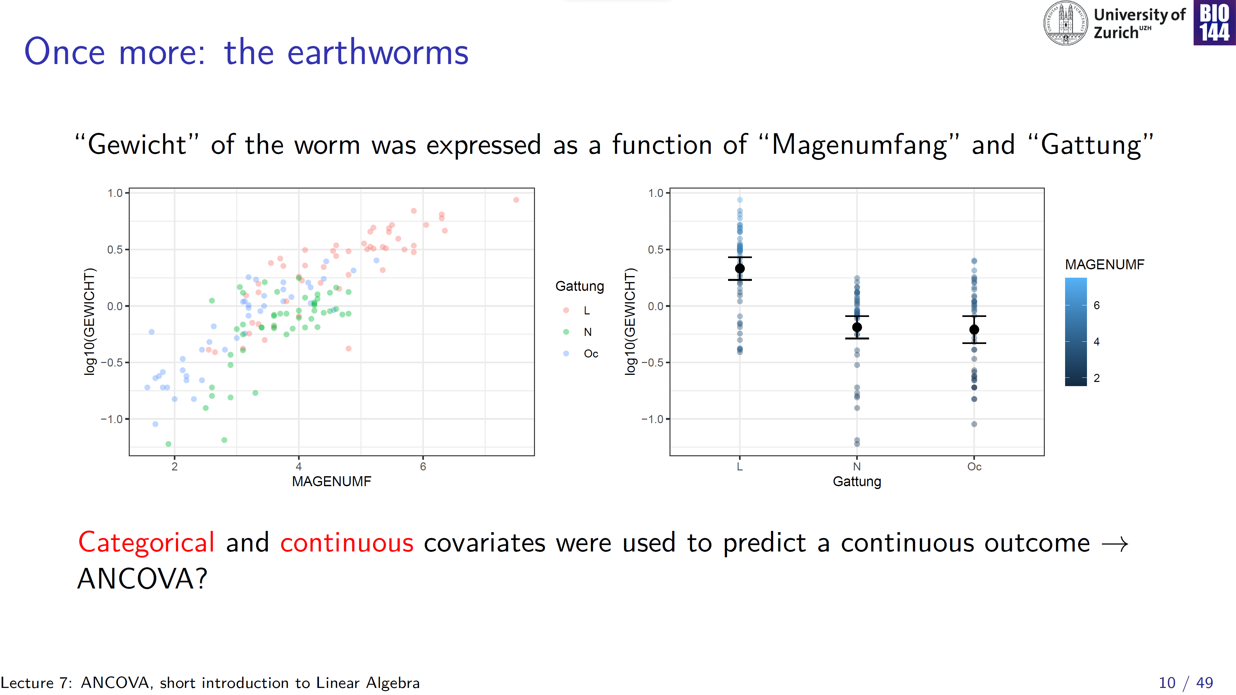
Research question:
“Do the 3 species have different mean weights, after controlling for the potential effect of gut-size?”

Slide 11
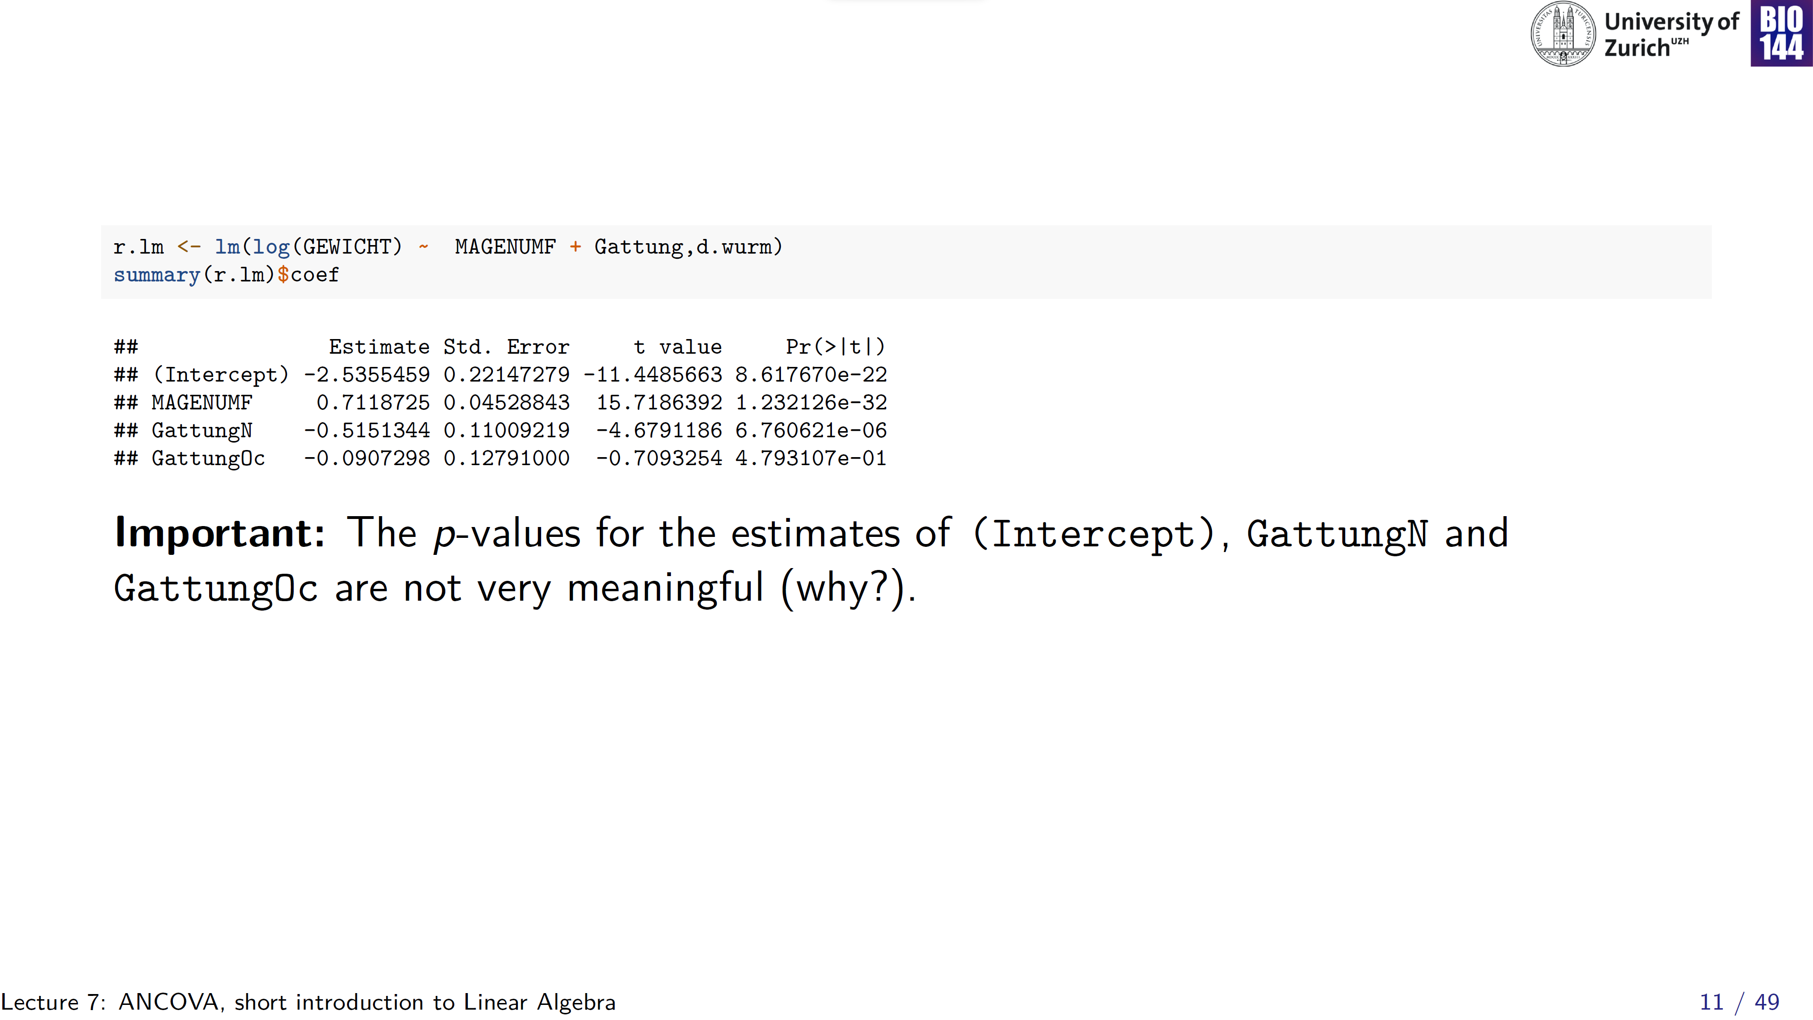
intercept= mean weight of species L at gut-size= 0
Multiple comparisons to same reference (inflated risk of Type I error):
1. Δ mean weight species L vs. species N at gut-size= 0
2. Δ mean weight species L vs. species Oc gut-size= 0

Slide 12
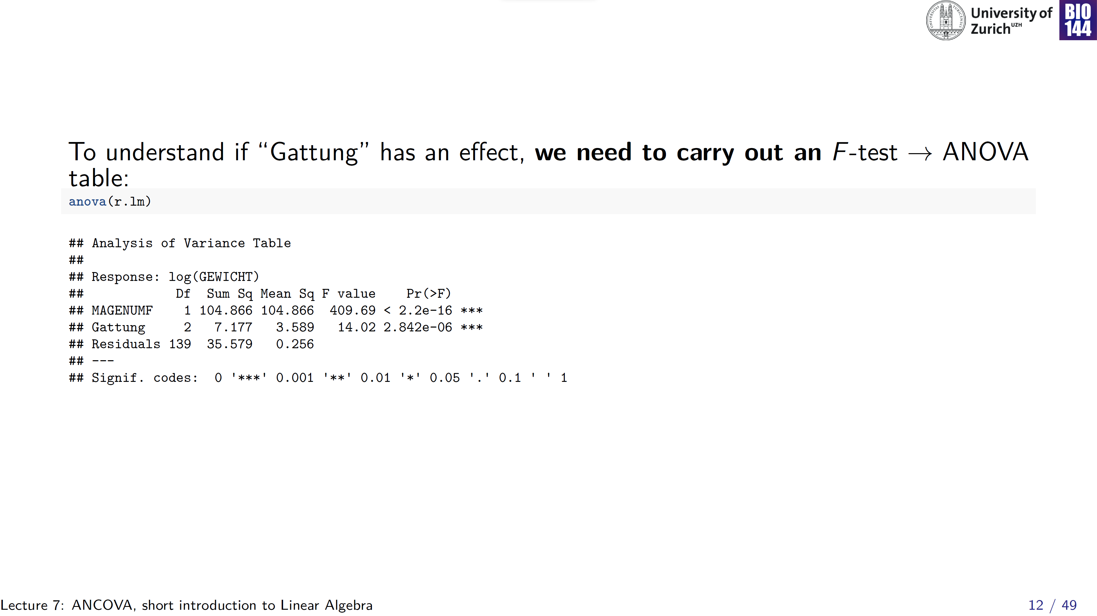

Slide 13
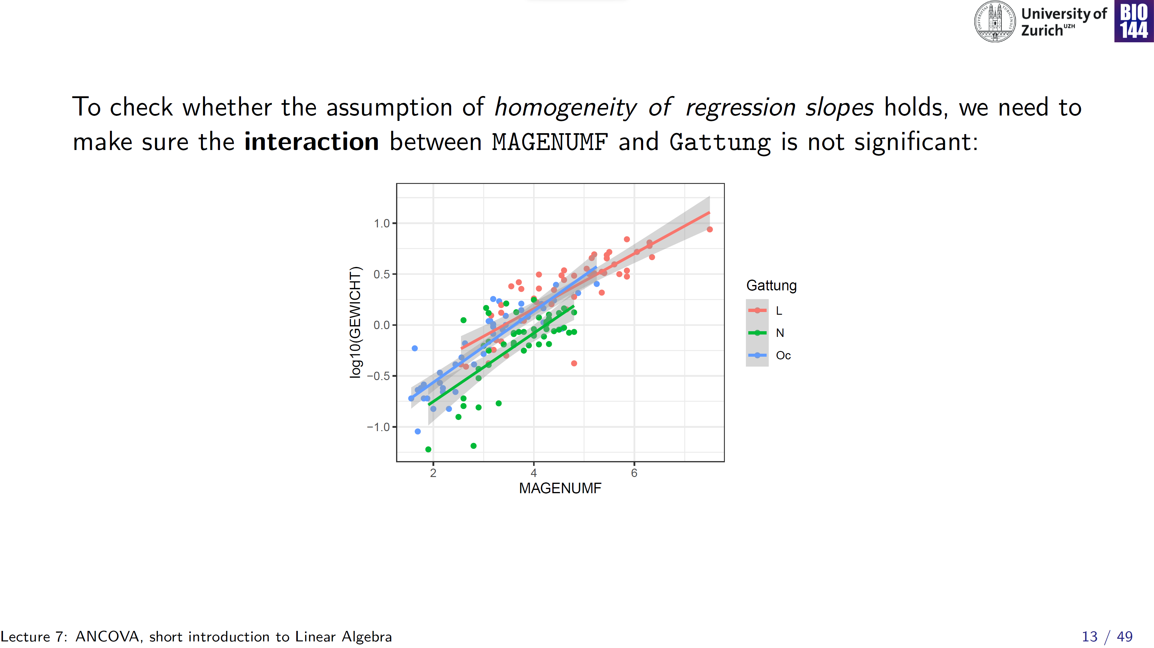
Slopes are similar
Seems reasonable, but let’s fit a model to formally test this

Slide 14
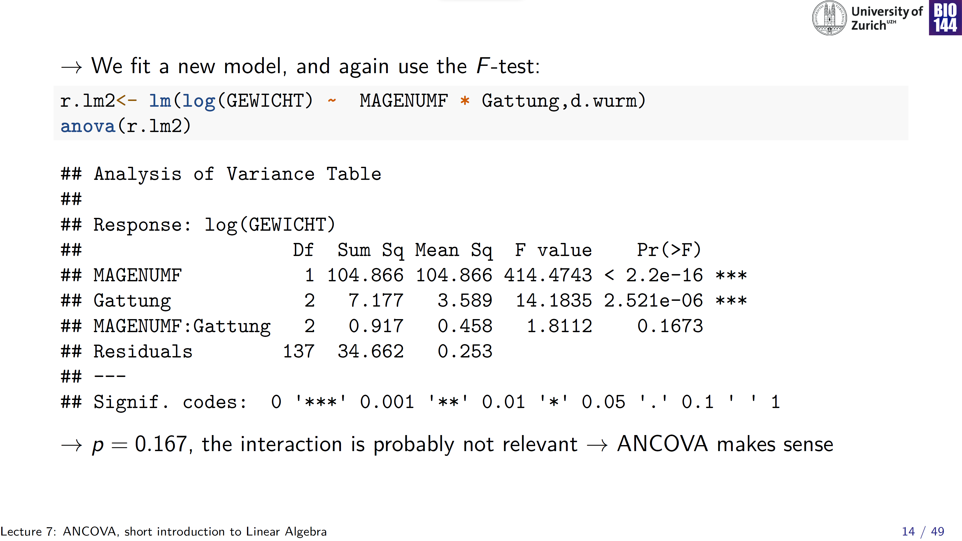
Read bottom-up

Slide 15
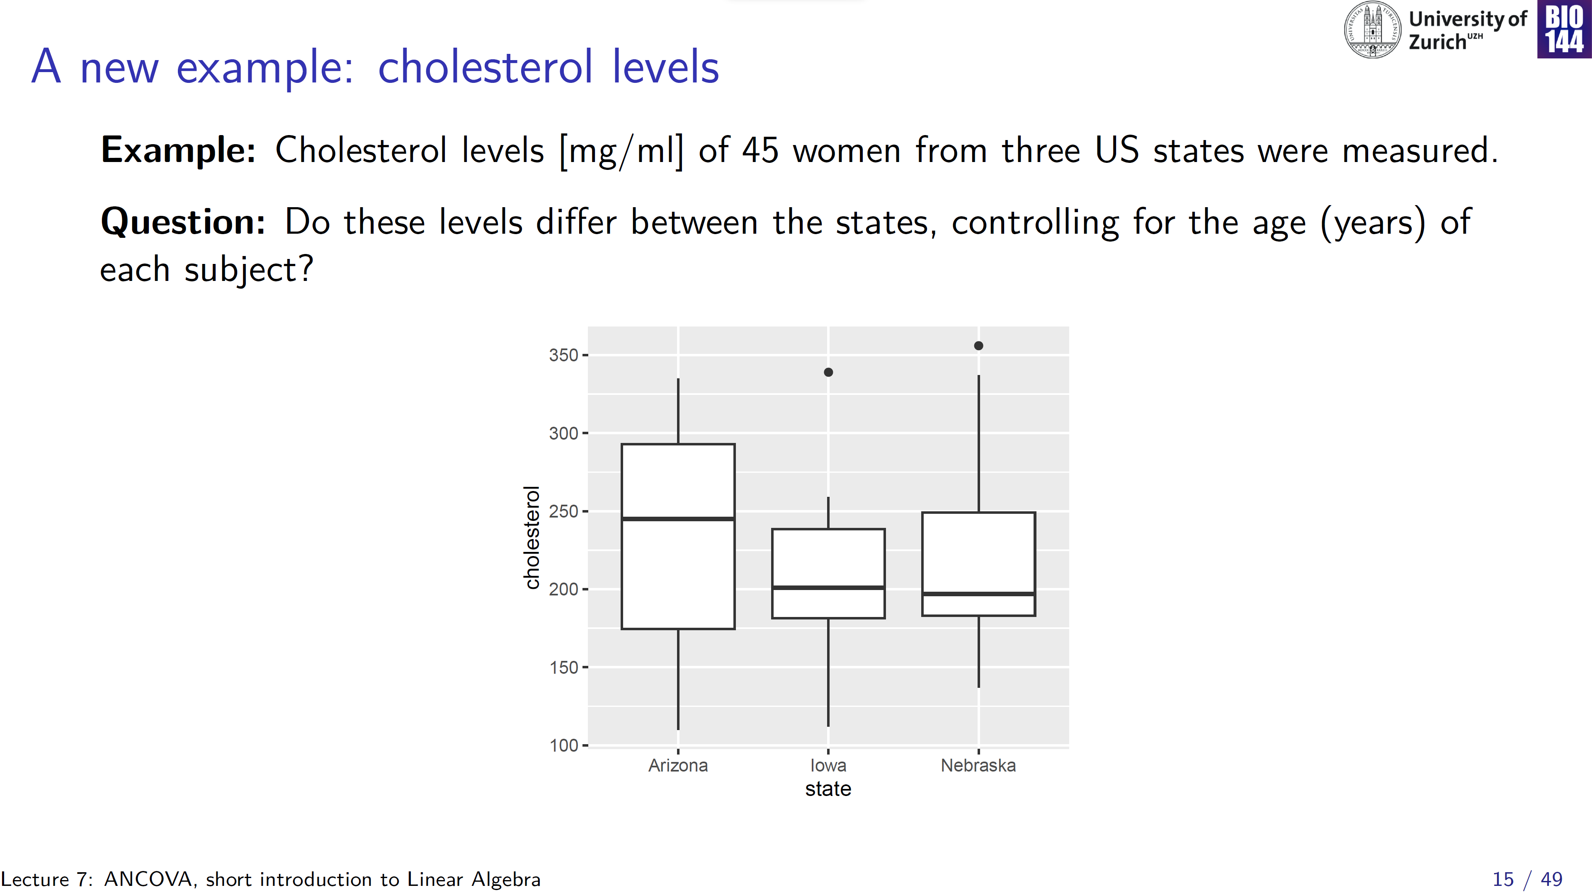

Slide 16
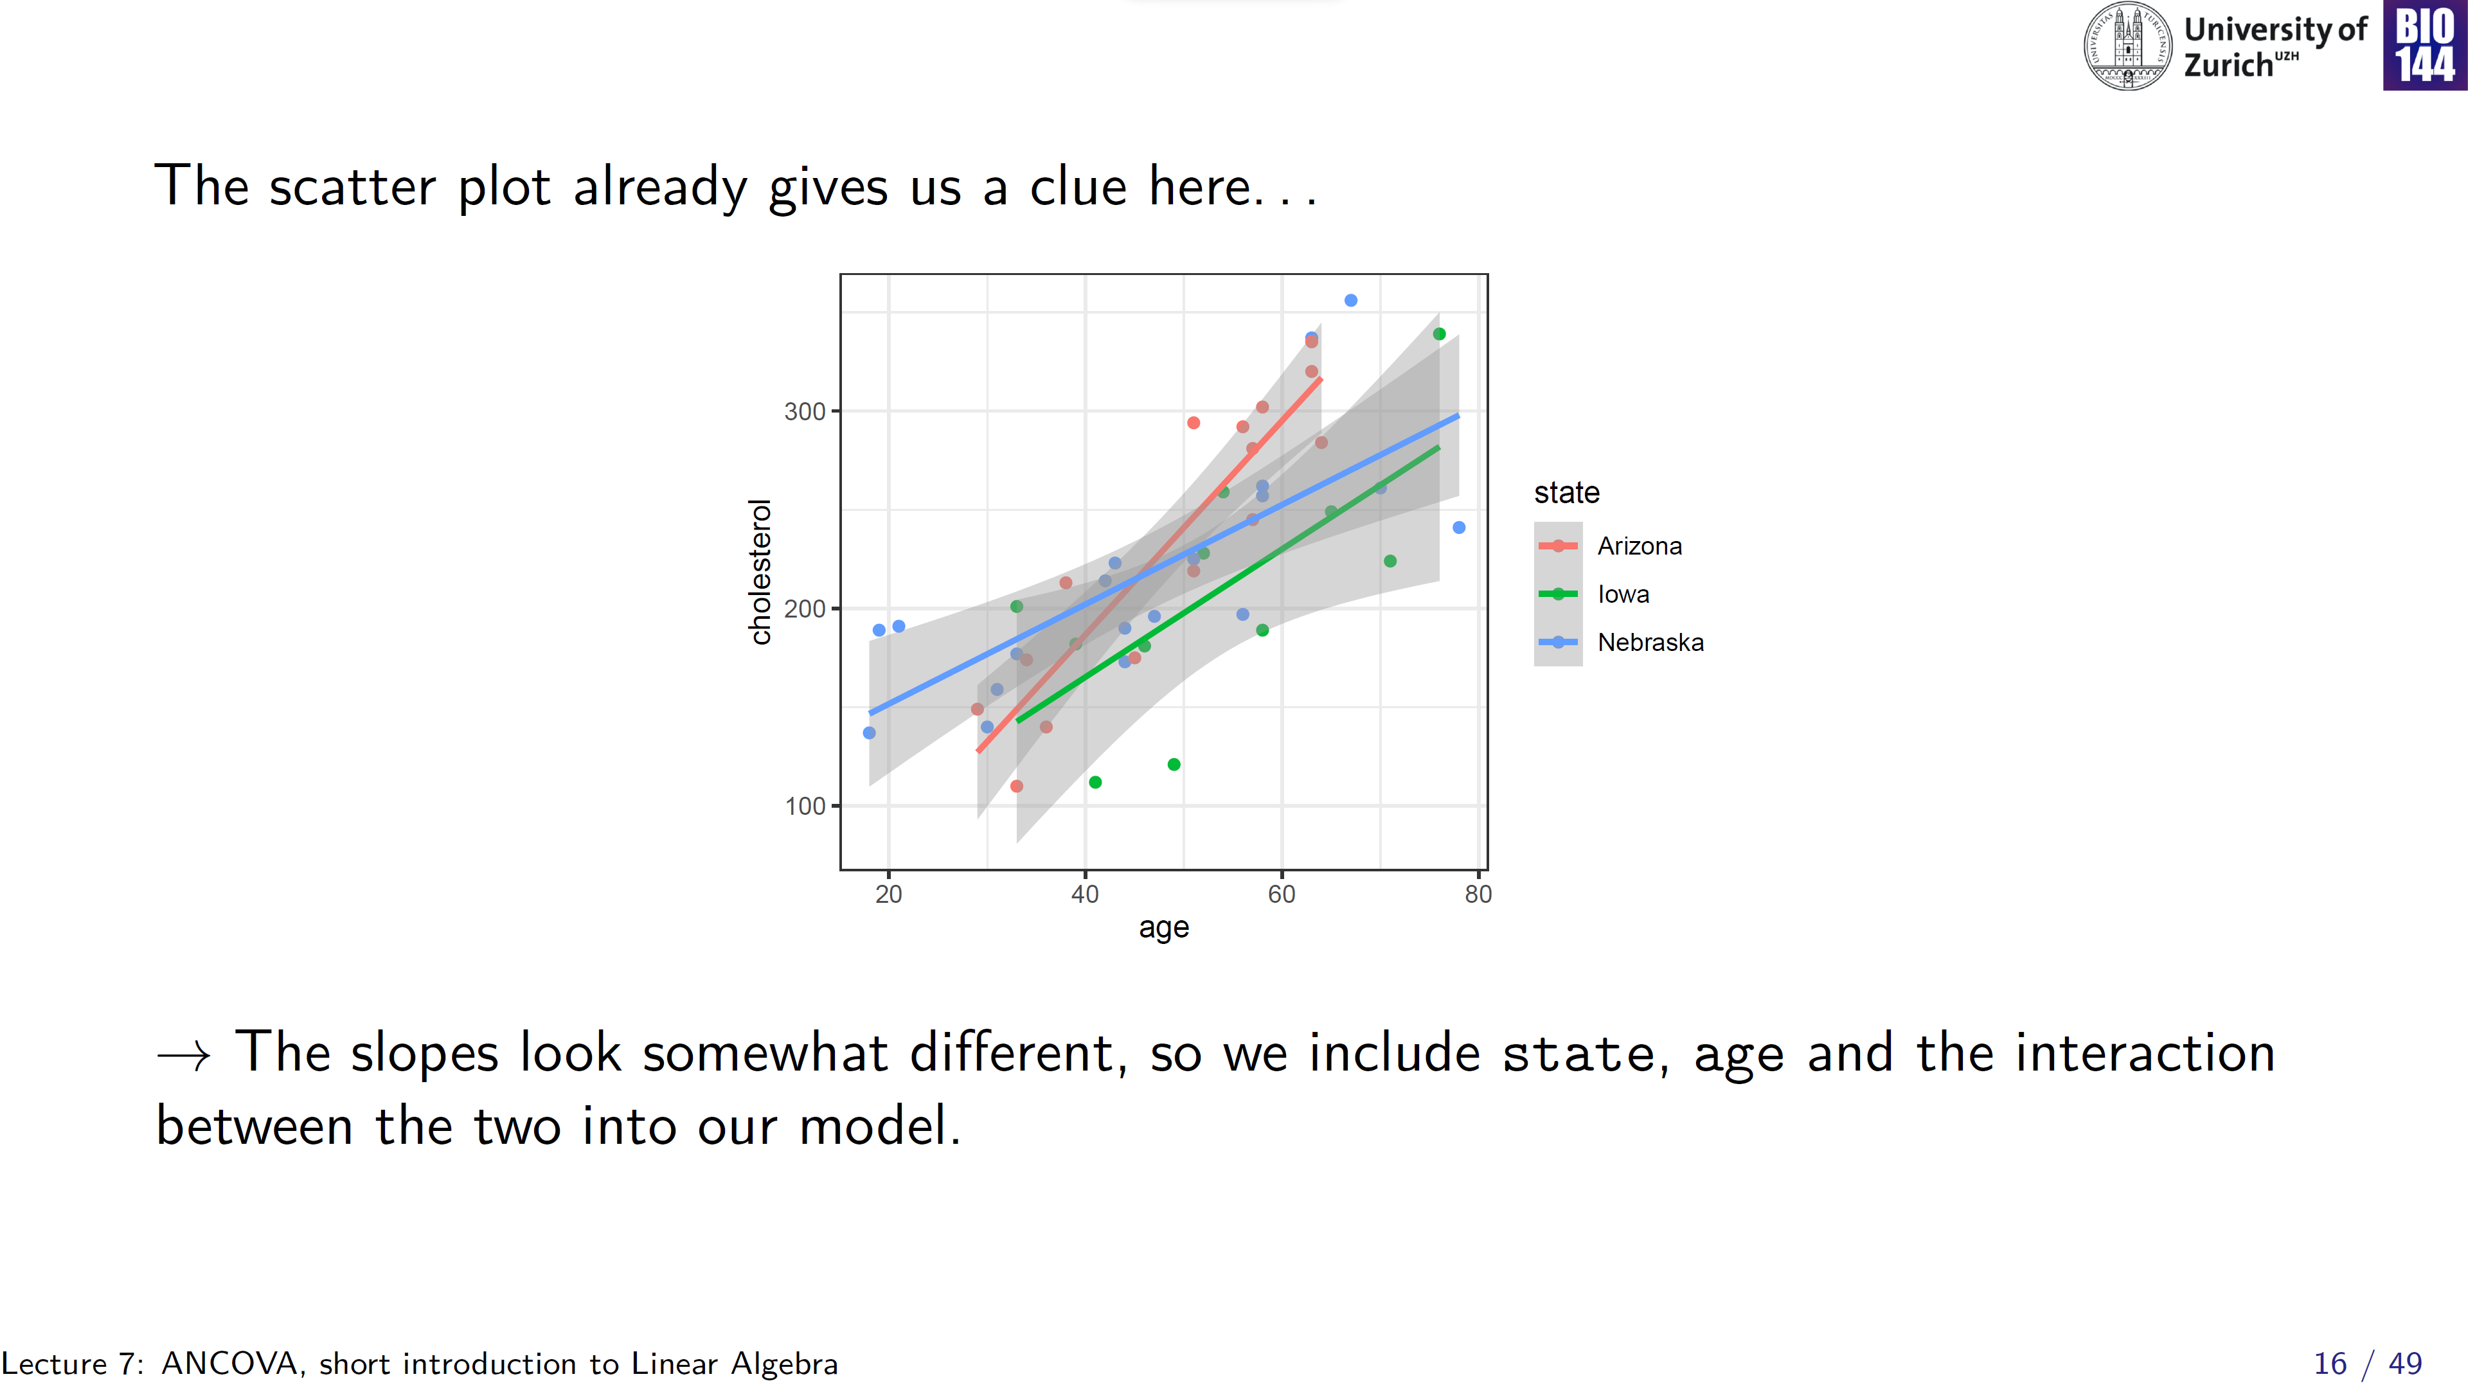
At age= 34:
N > A > I
At age= 64:
A > N > I
Can we still assume homogeneity of the regression slopes?

Slide 17
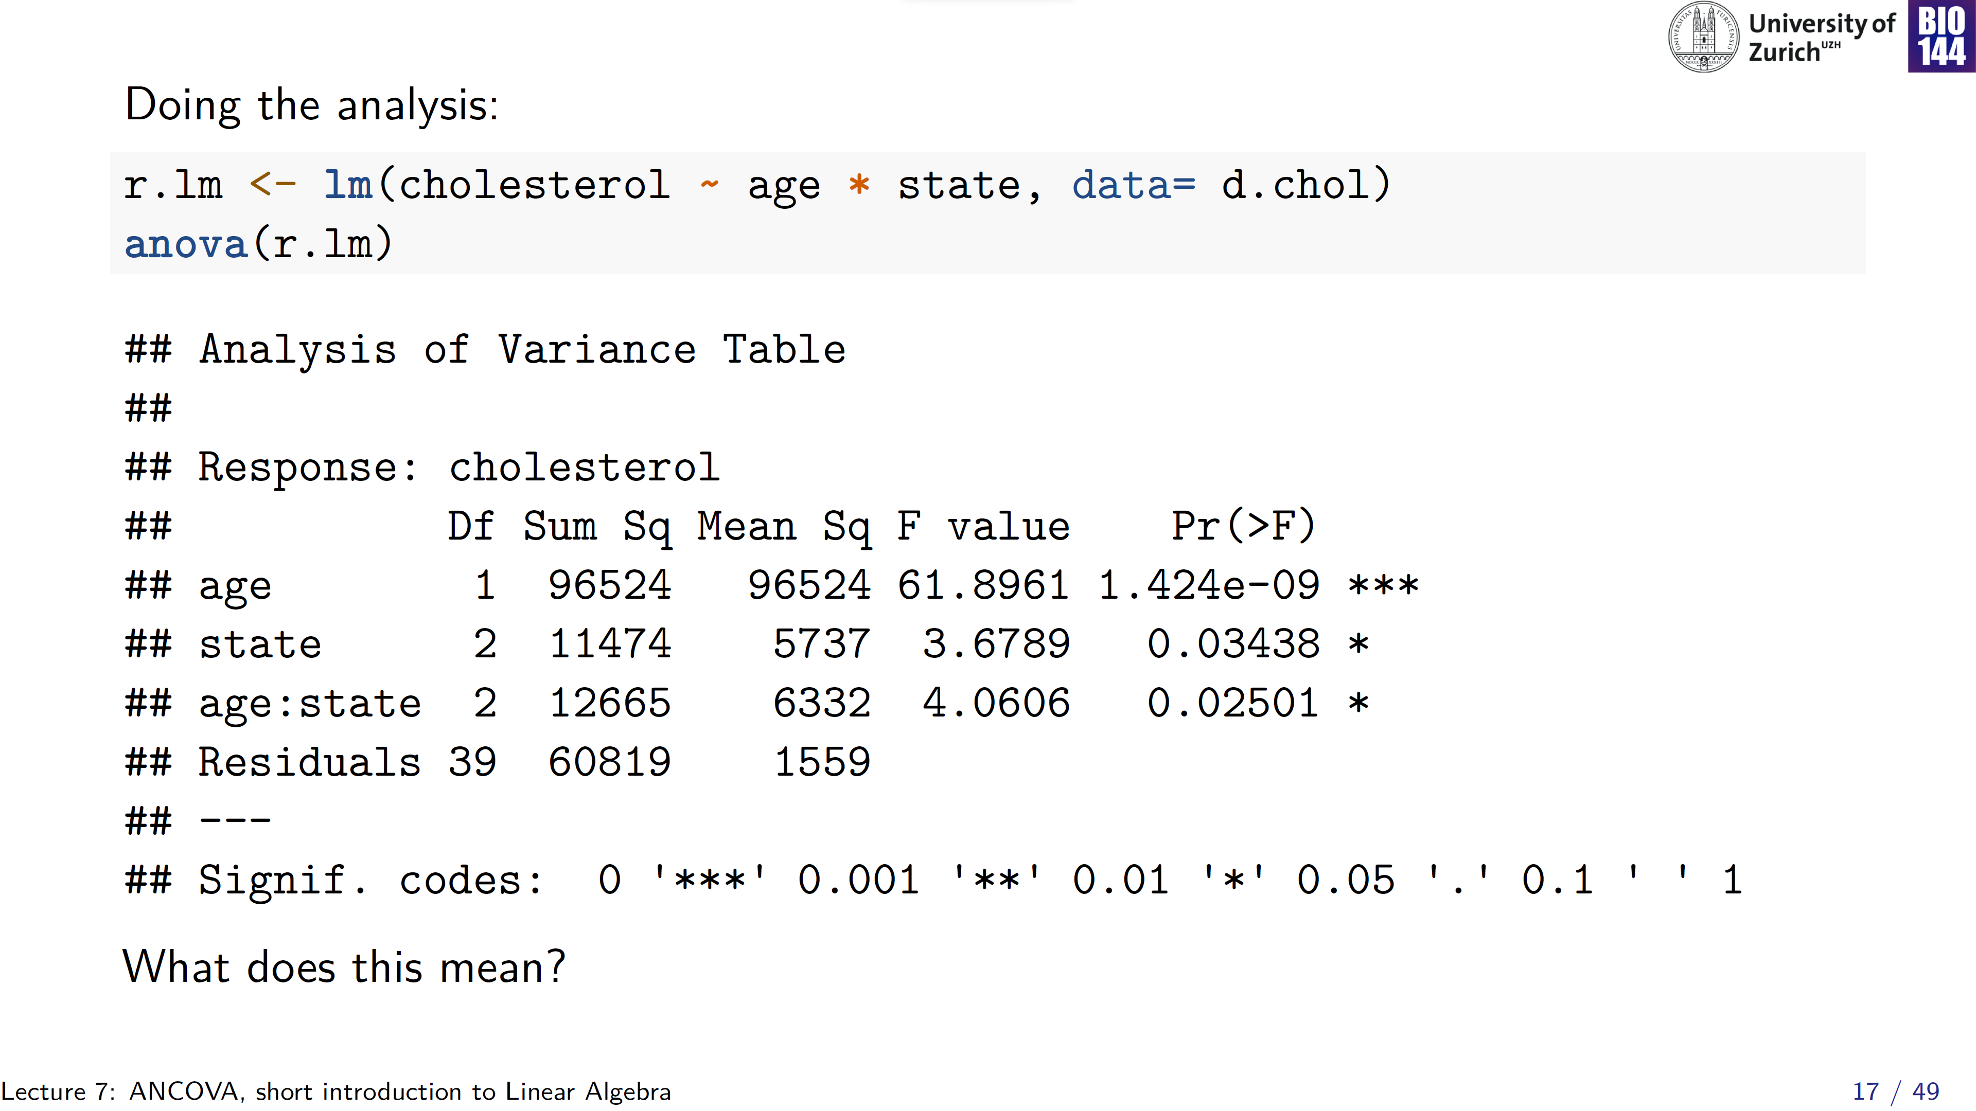
Read bottom-up
Comparing means across states alone is not informative!

Slide 18
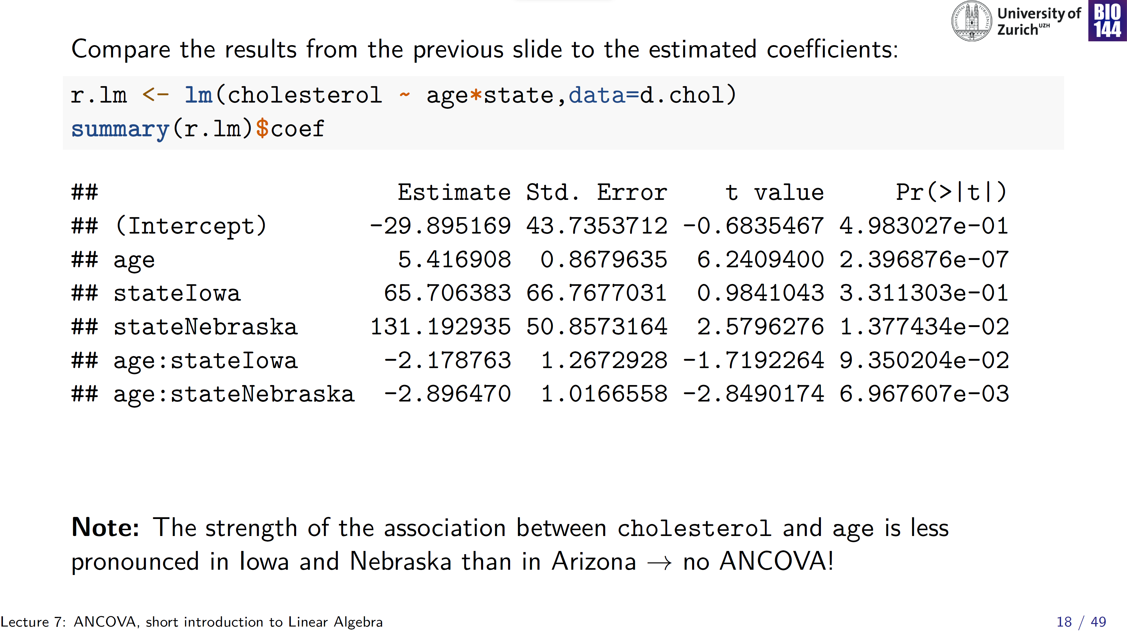
Mean cholesterol in Arizona at age= 0
Slope in Arizona
Δ mean
Δ slope of age in Nebraska vs. Arizona; so the slope in Nebraska is 5.42 – 2.90= 2.52

Slide 19
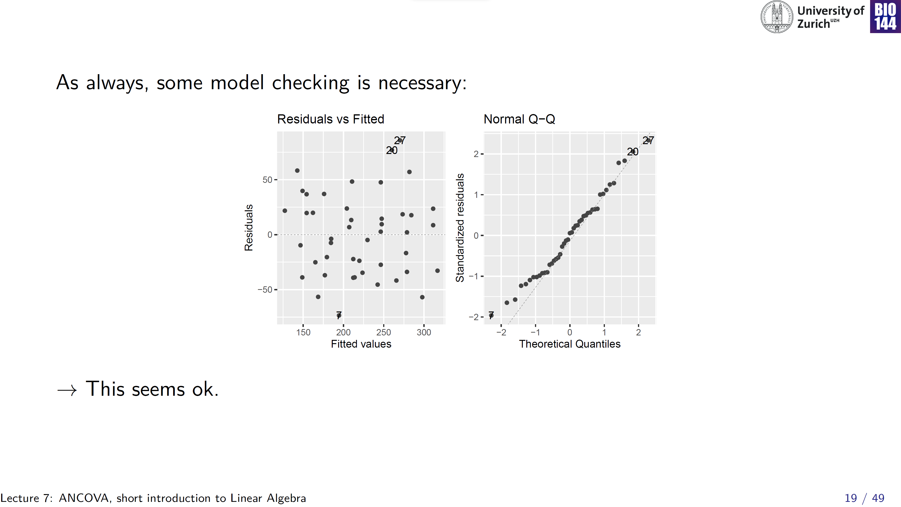

Slide 20
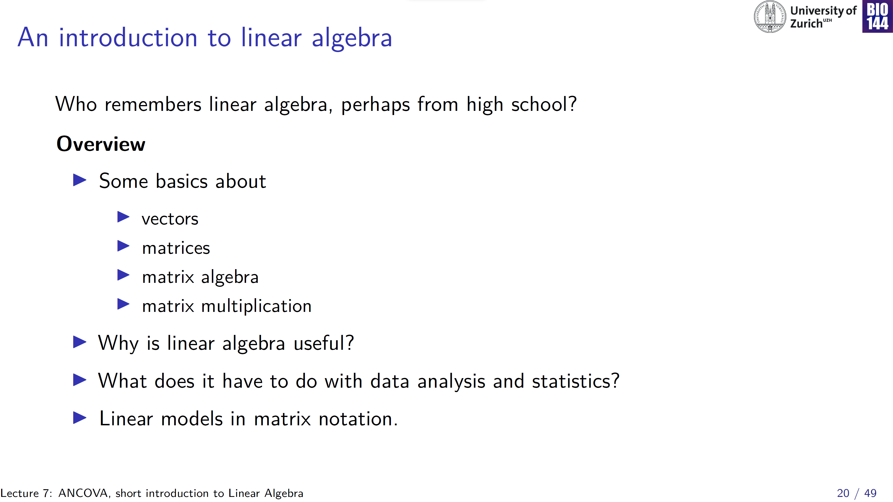

Slide 21
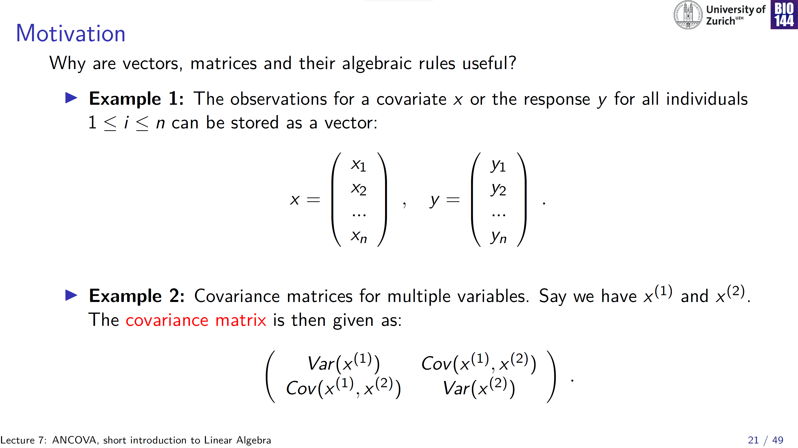
Think of as columns in a spreadsheet
X⁽¹⁾
X⁽²⁾
X⁽¹⁾
X⁽²⁾
Variance is on the diagonal

Slide 22
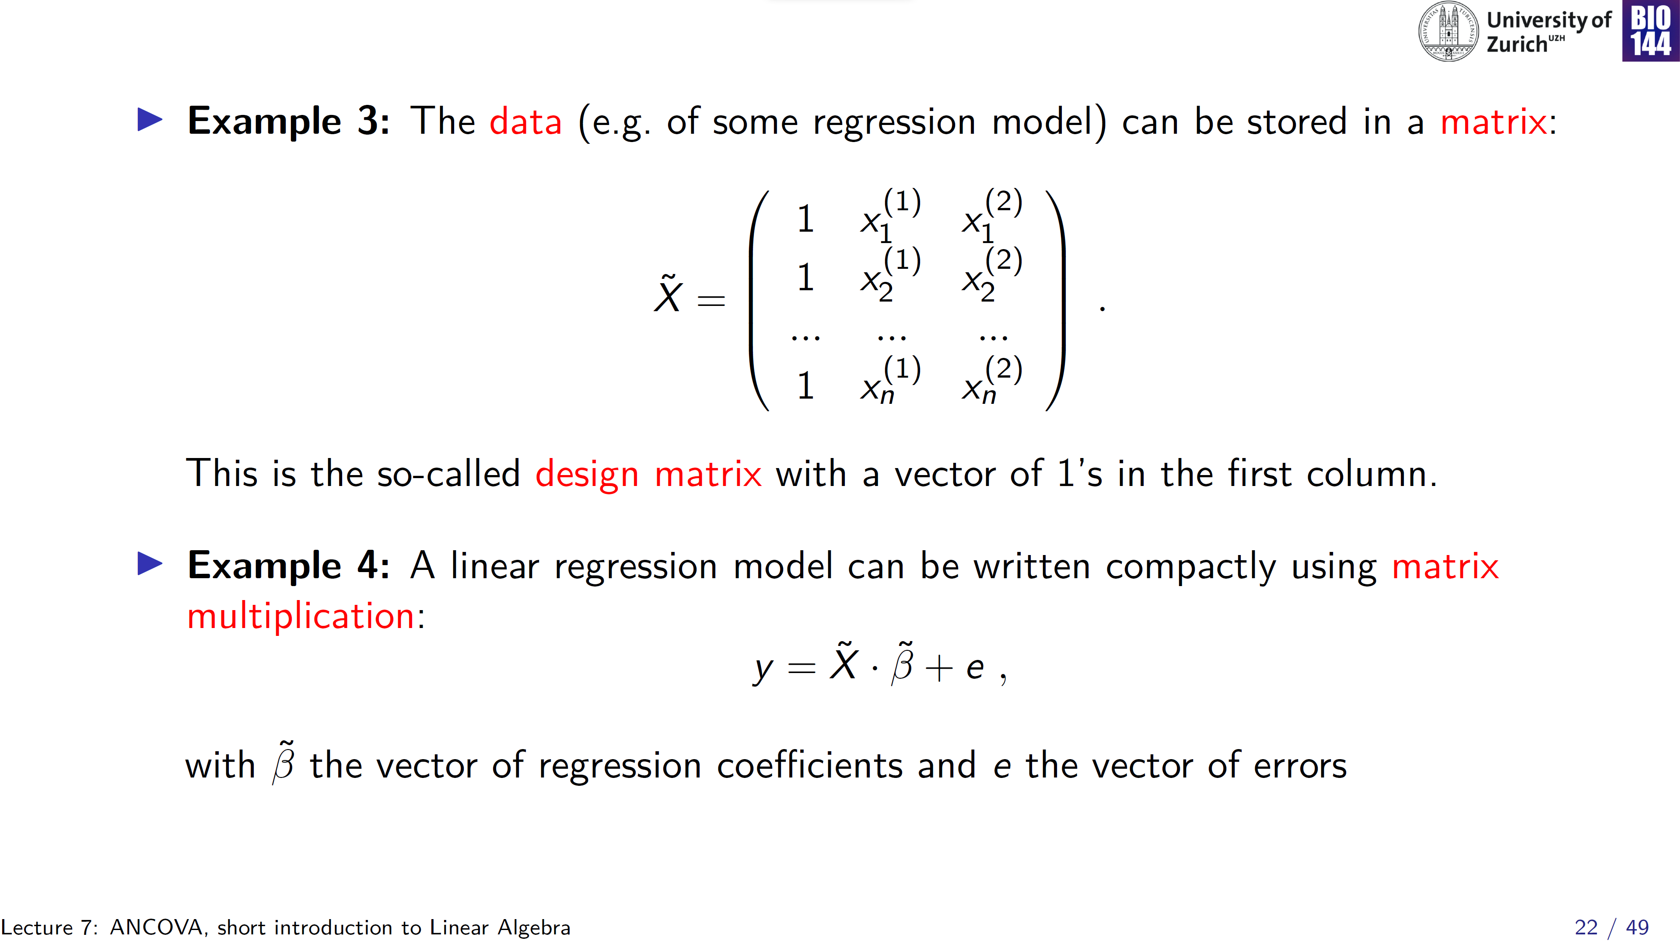
Intercept
Var 1
Var 2
(pronounced as: “x tilde”)
(also called: the model parameters)
Notes:
The product of the design matrix and the vector of parameters plus a vector of errors

Slide 23
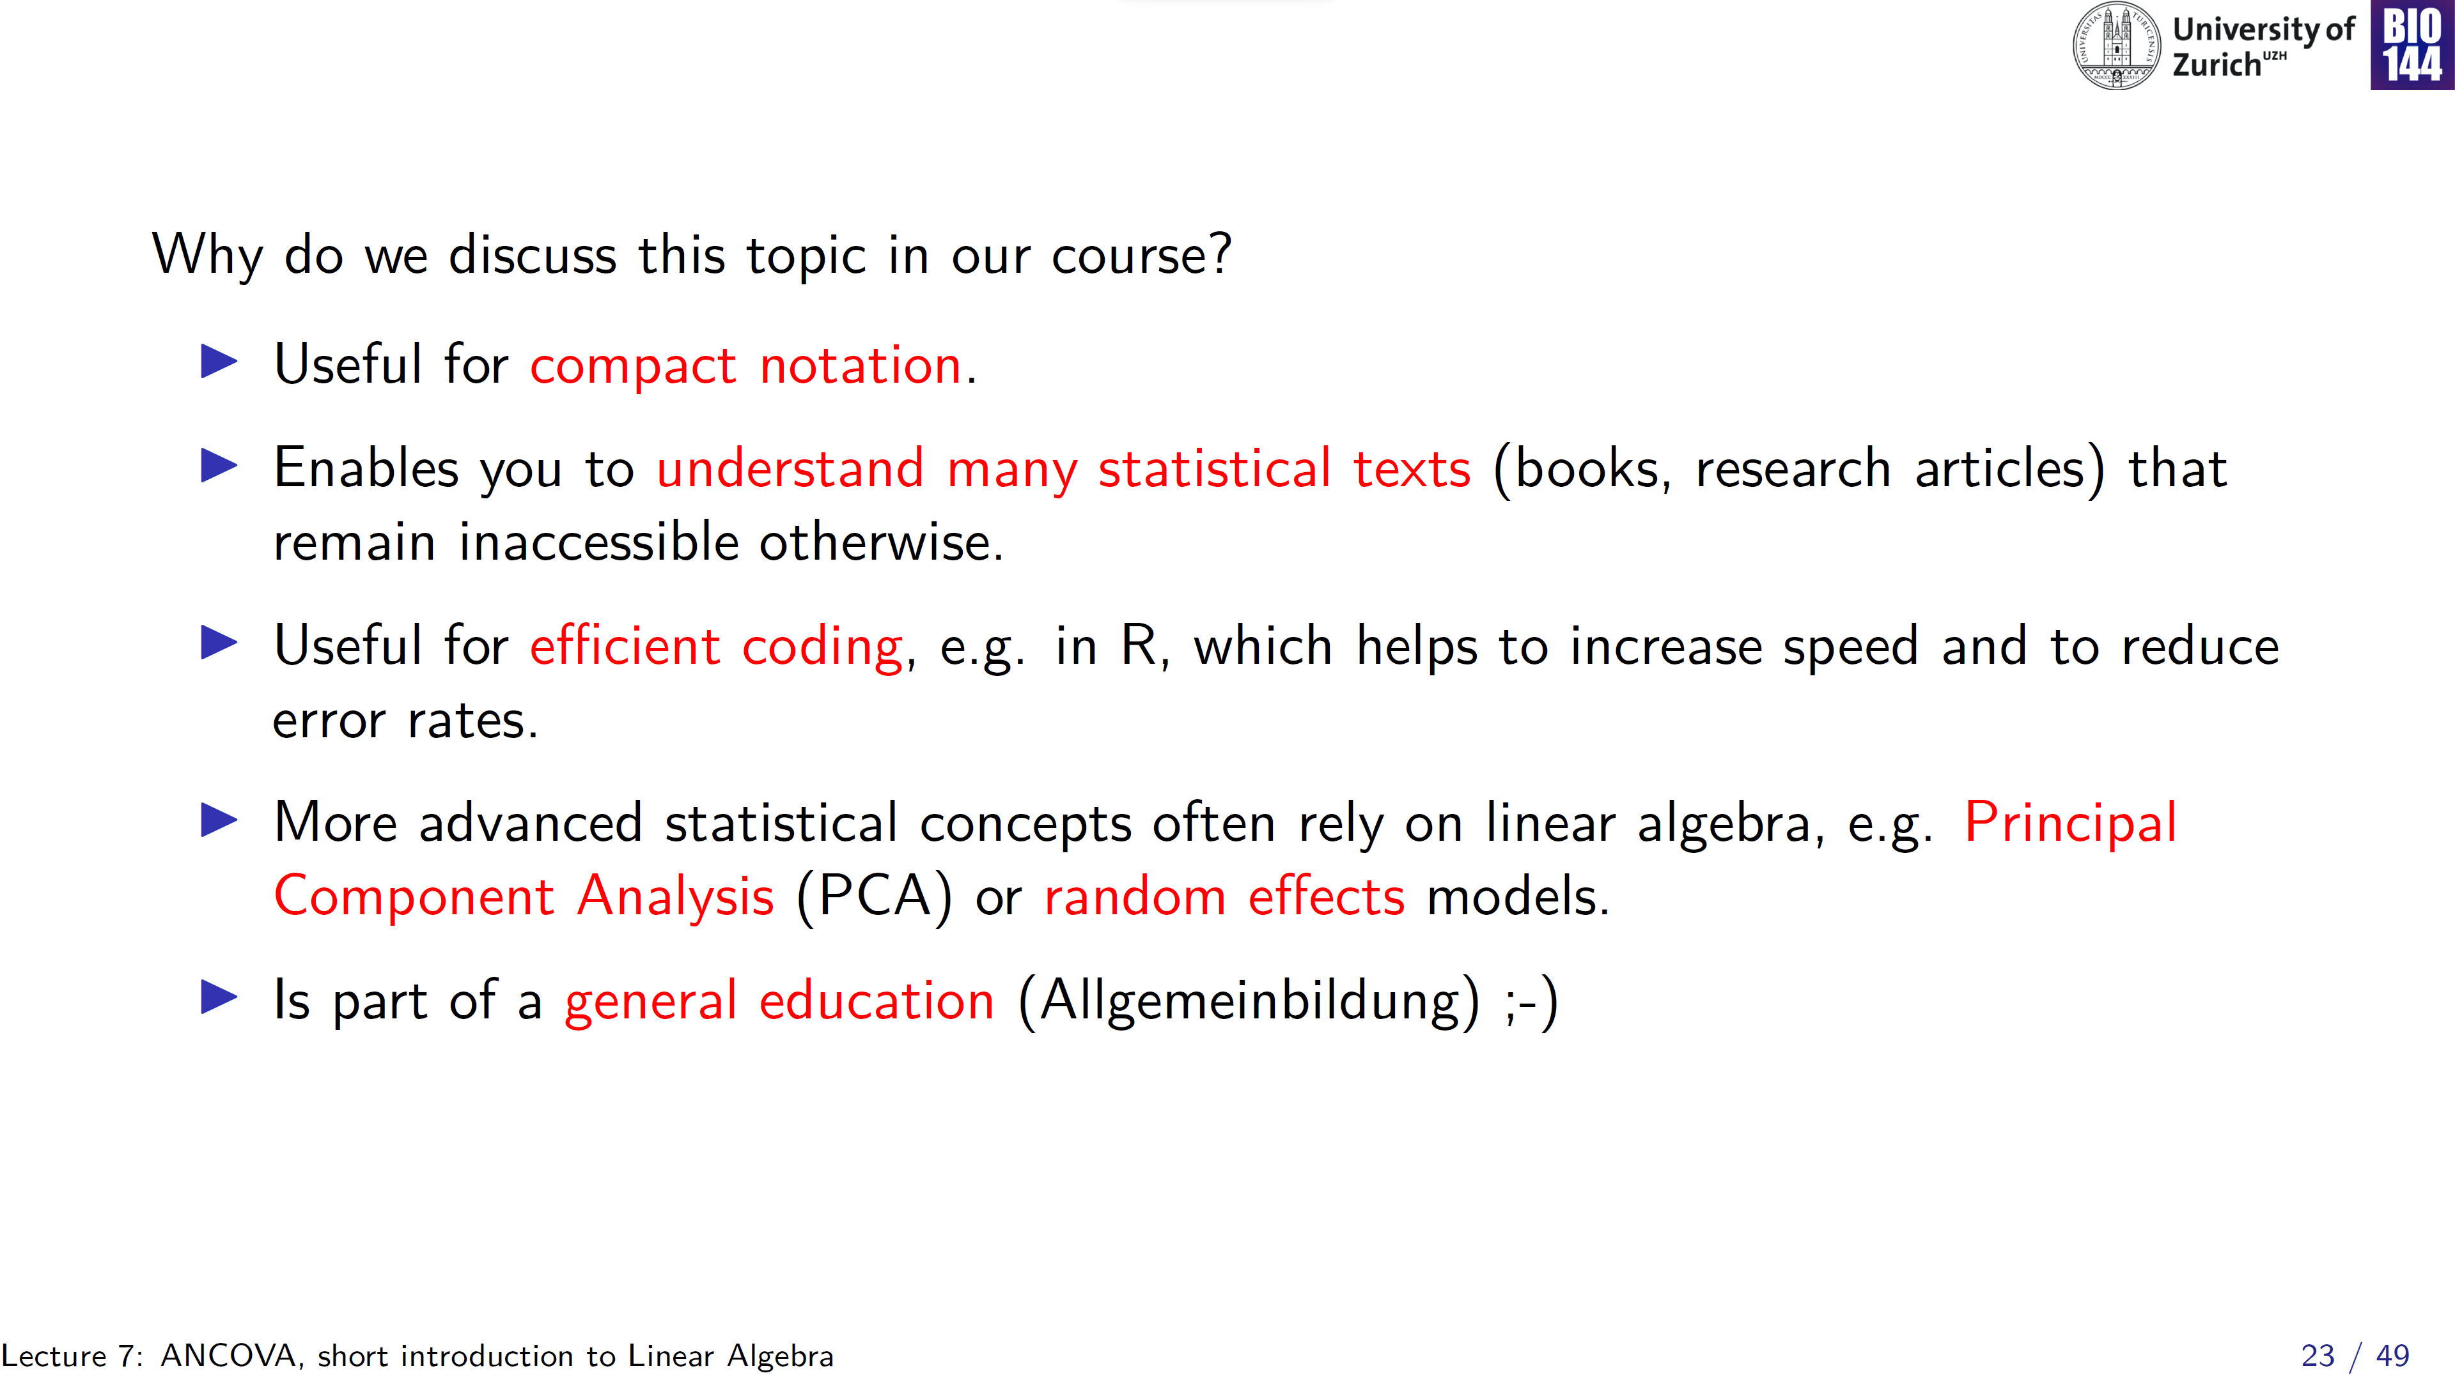
Well…
Notes:
Steffie is a mathematician…

Slide 24
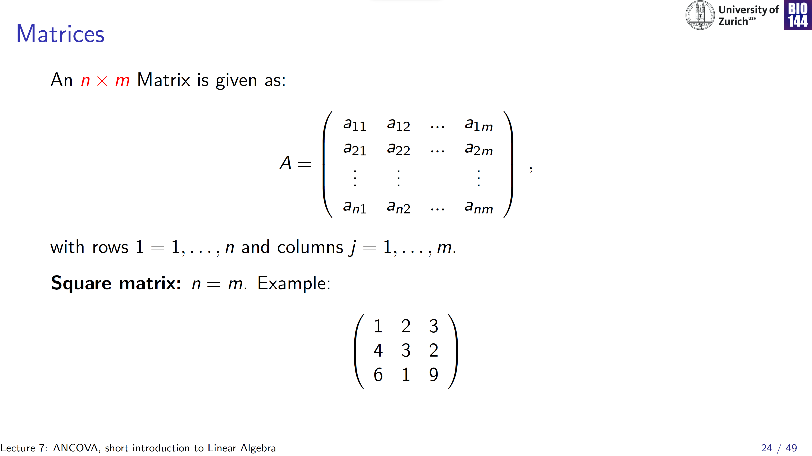
n _{rows}
n _{columns}
= 3
Notes:
Matrix capital A, individual values or elements, small a, indexed by row nr col number

Slide 25
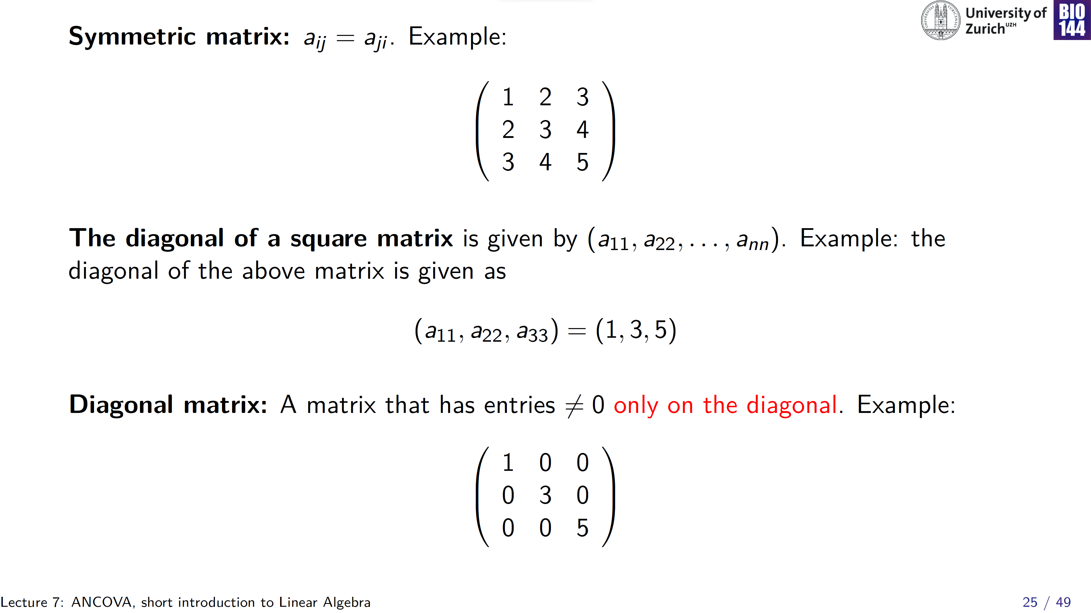
Notes:
Diagonal: in the index, n row = n col

Slide 26
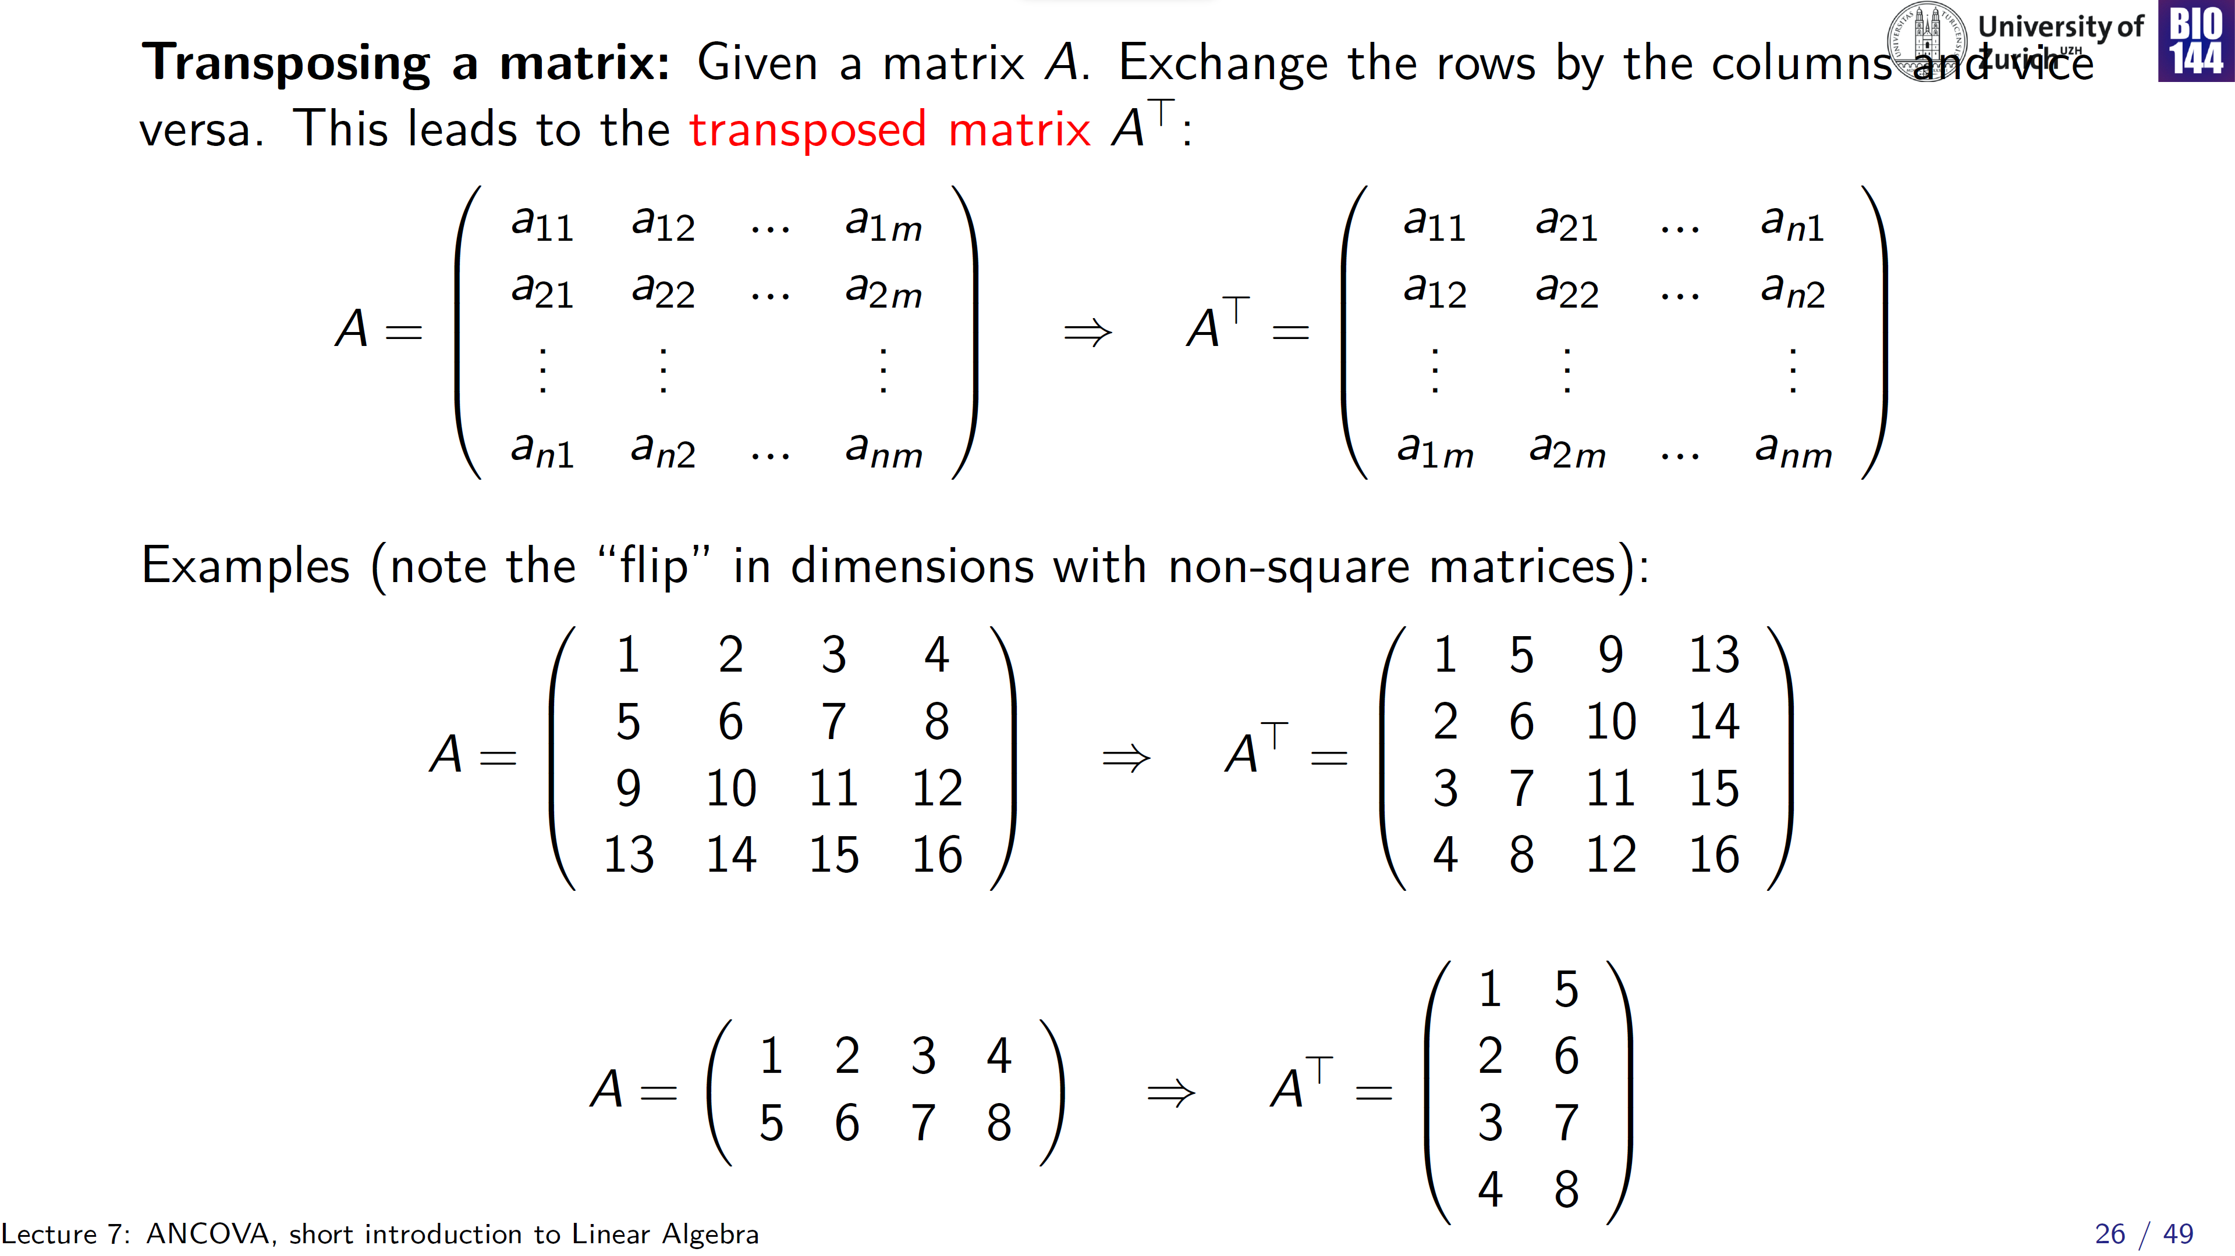
[2 x 4] matrix [4 x 2] matrix
Notes:
IN square matrices: first row becomes first column, second row becomes second column, etc.
In non-square matrices, the same: first row becomes first column, etc -> this changes the dimensionality of the matrix

Slide 27
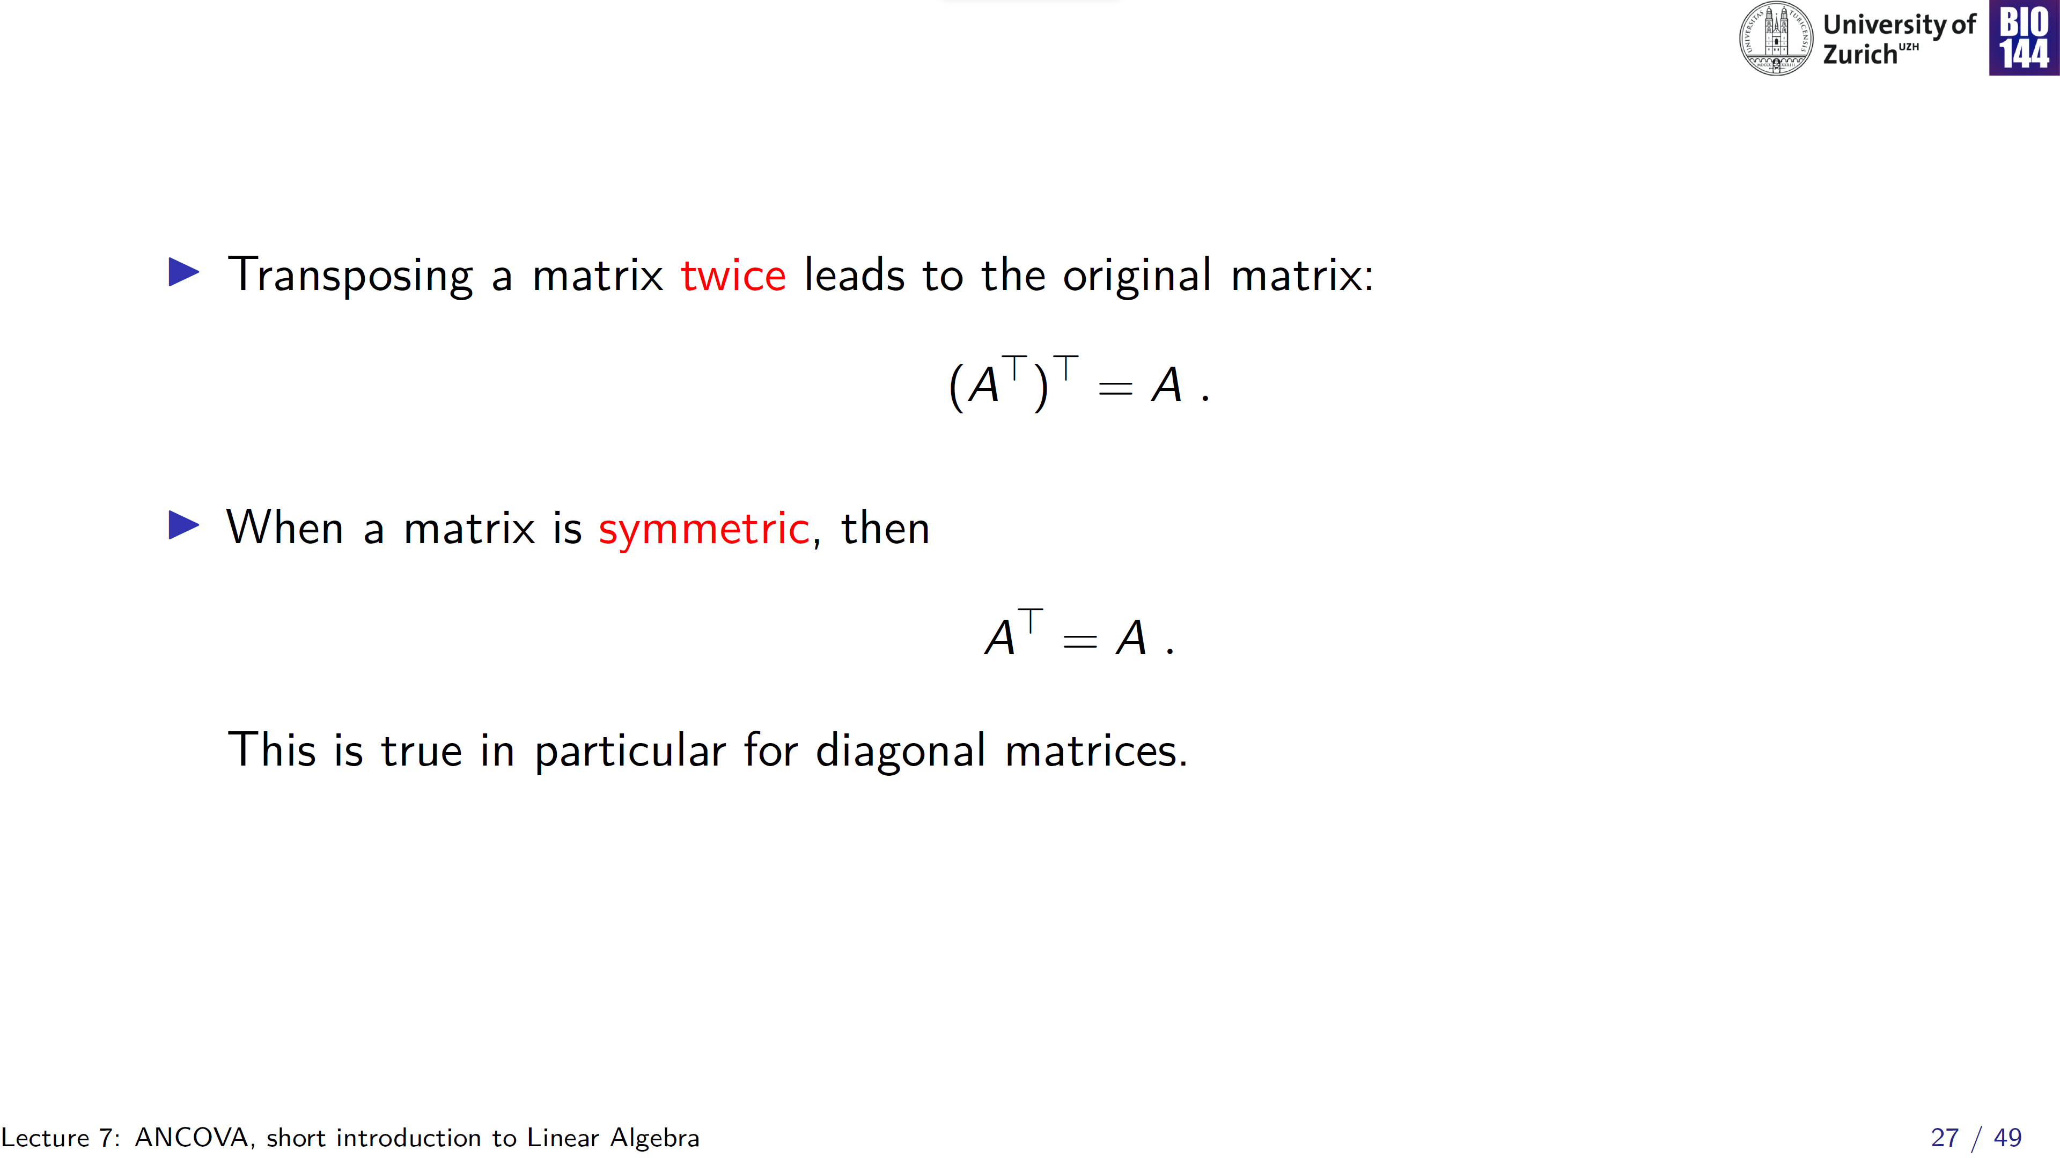

Slide 28
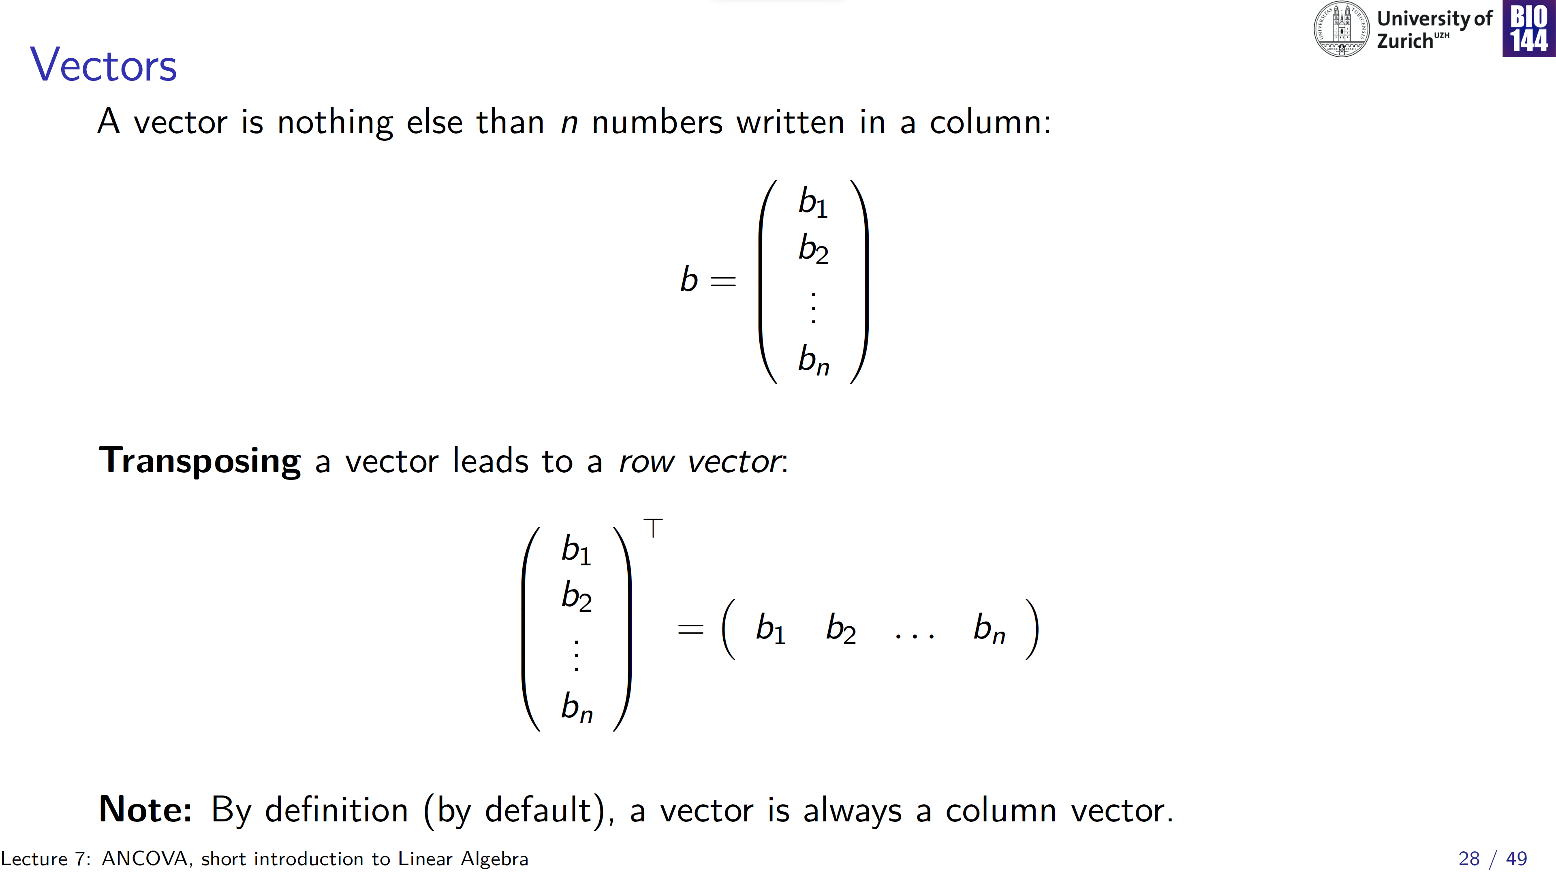
[n x 1] matrix
[1 x n] matrix

Slide 29
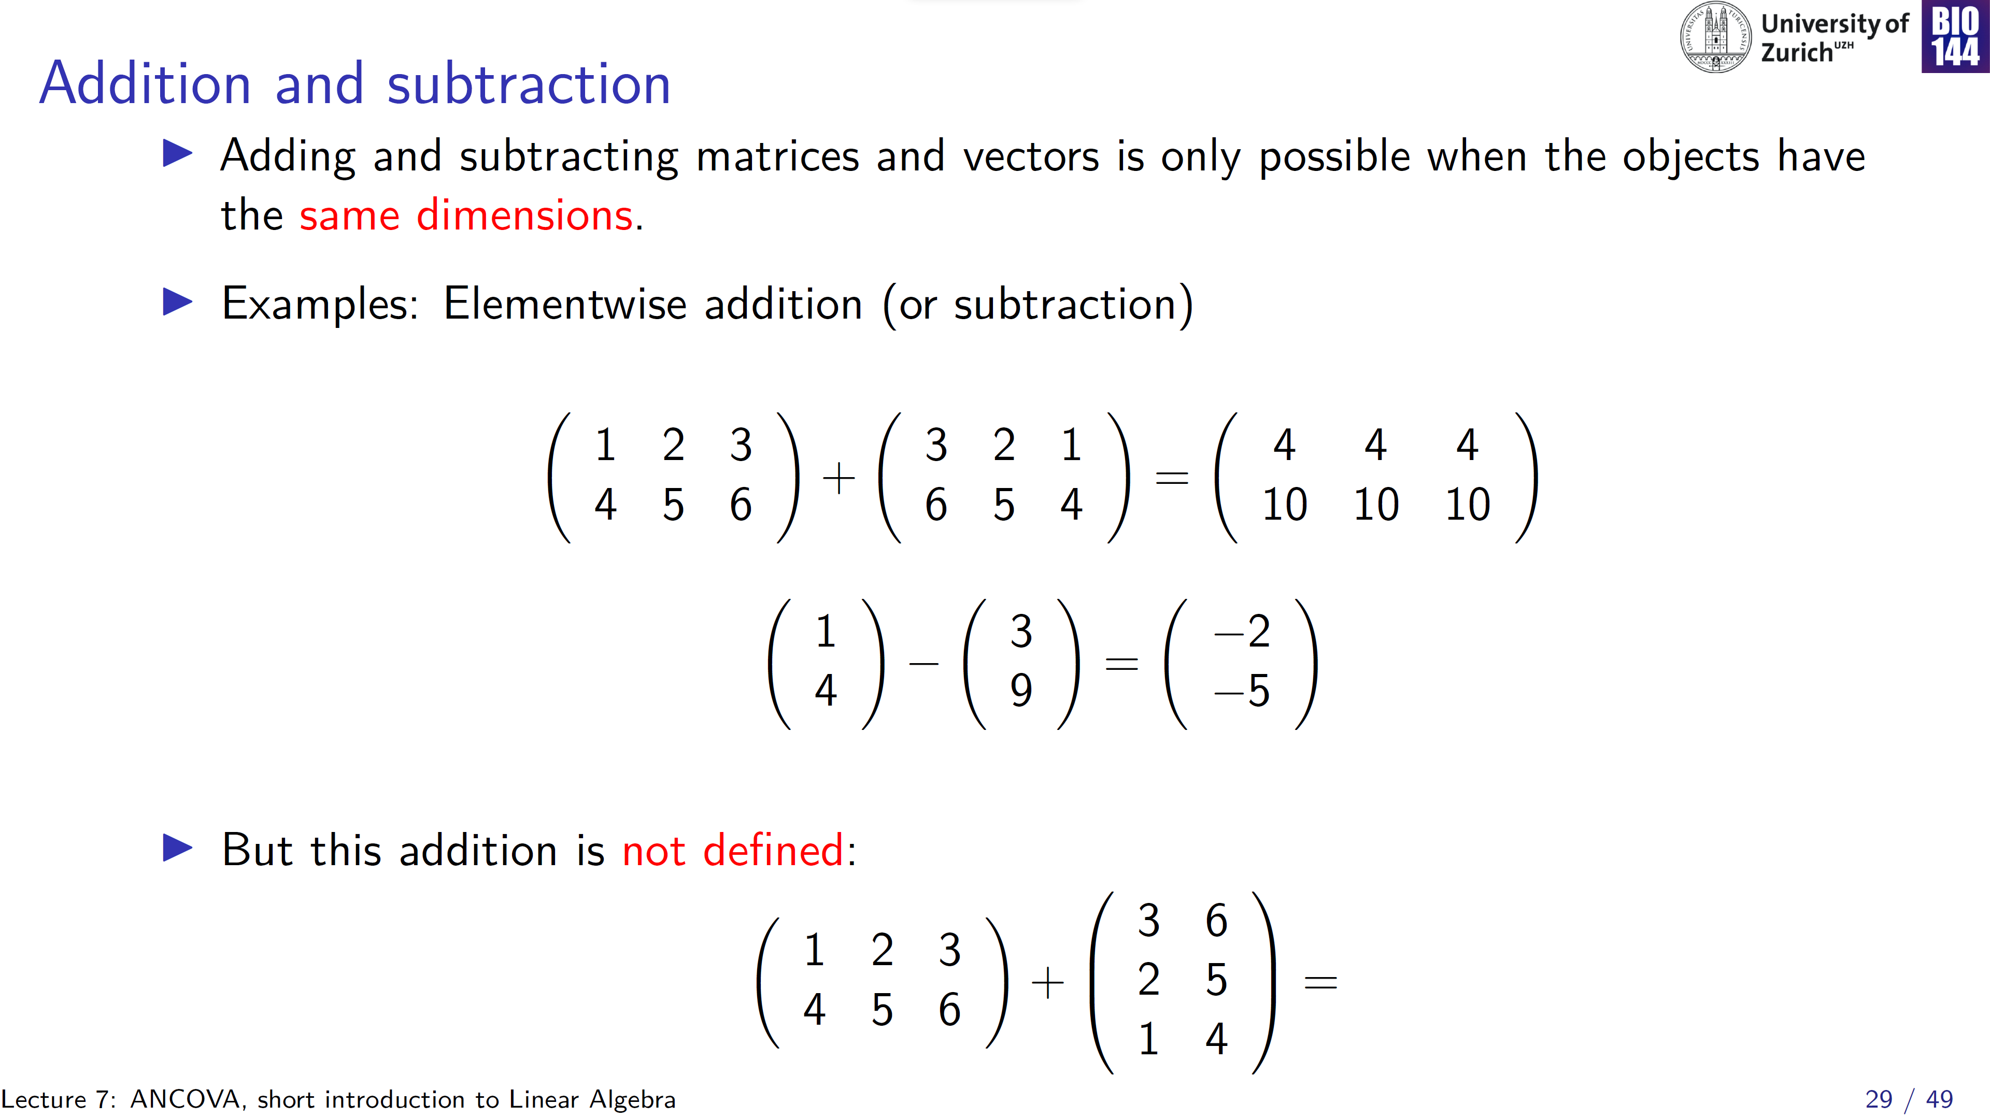
[2 x 3] matrix [3 x 2] matrix
?!

Slide 30
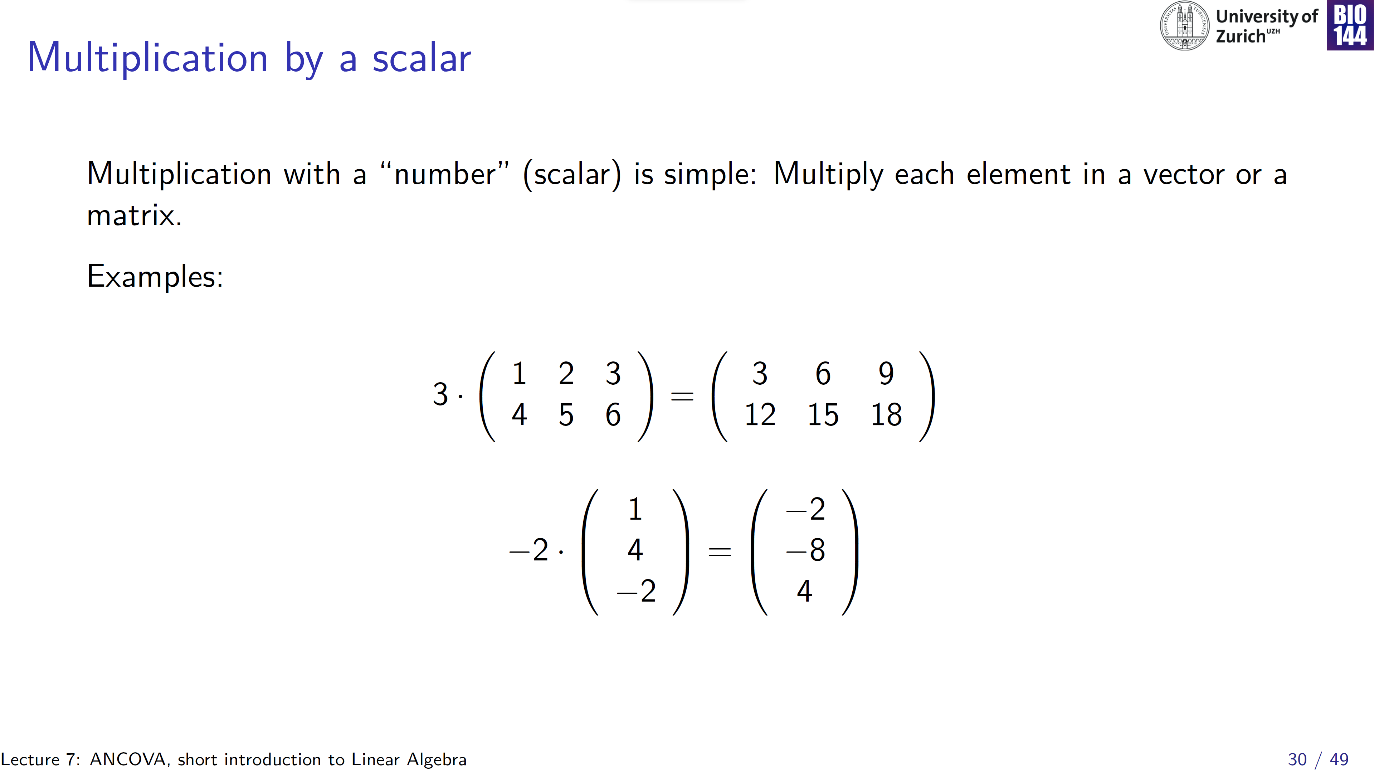
[1 x 1] matrix

Slide 31
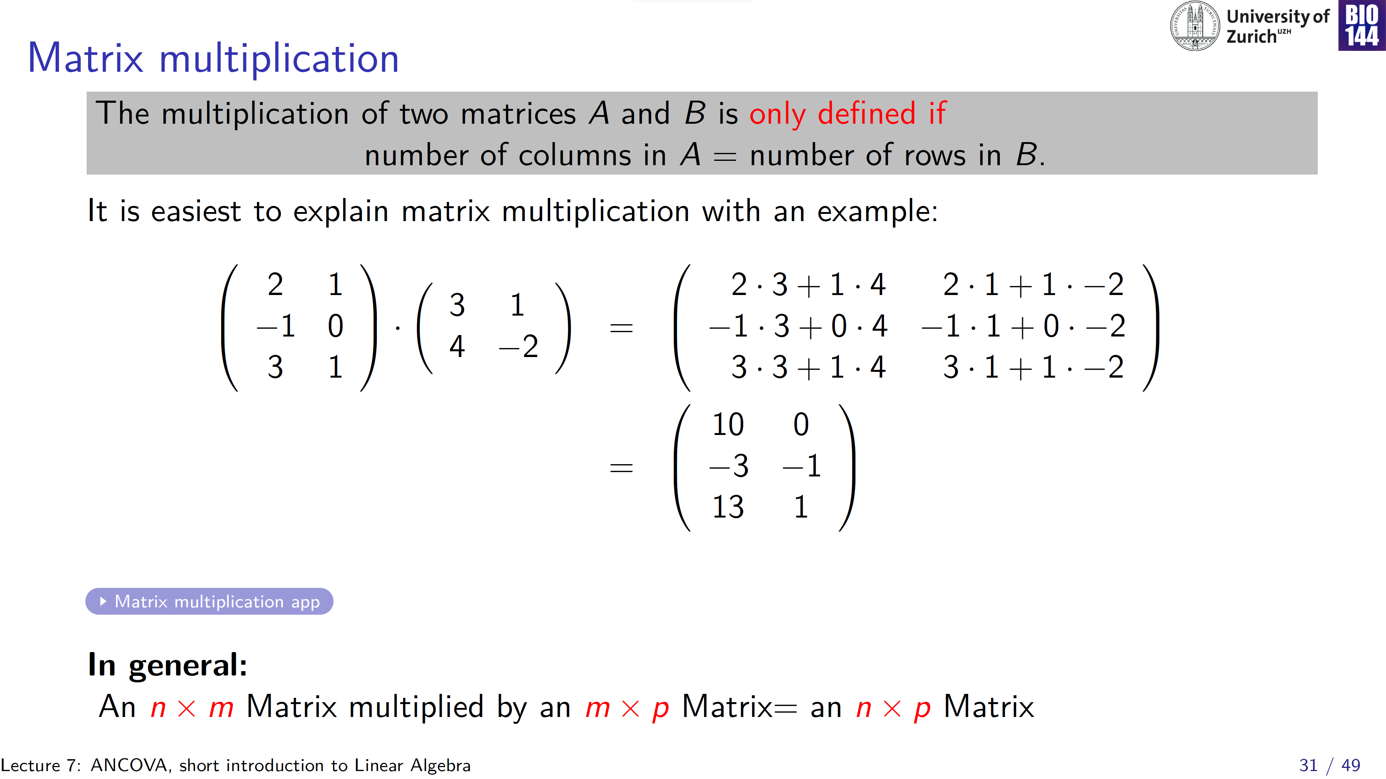
[3 x 2] matrix [2 x 2] matrix
Have to be equal
[3 x 2] matrix

Slide 32
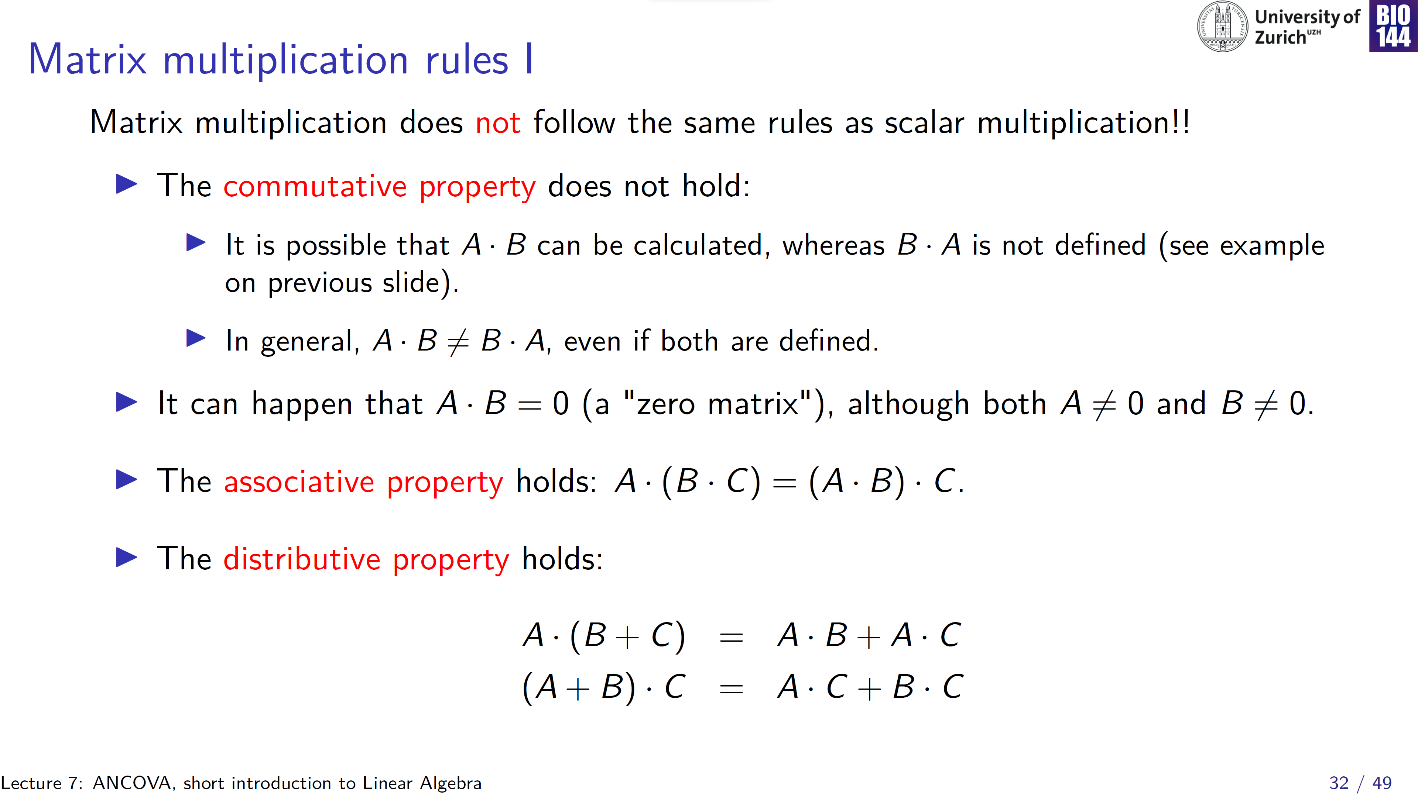
!!
Because the dimensions are off:
[3 x 2] matrix • [2 x 2] matrix
vs.
[2 x 2] matrix • [3 x 2] matrix

Slide 33
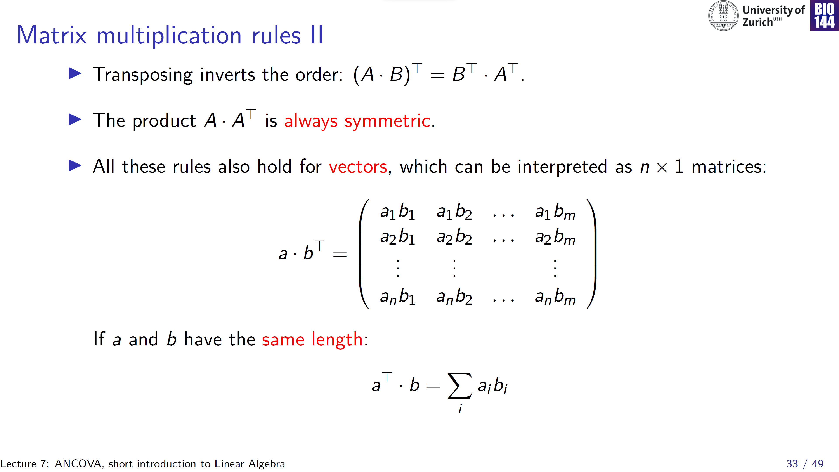
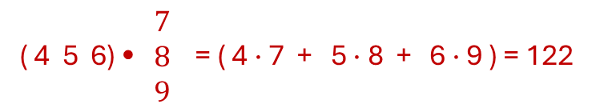
column vector • row vector
[n x 1] • [1 x m] = [n x m]
= scalar
( 4 5 6) • $\begin{matrix}7 \\ 8 \\ 9\end{matrix}$ = ( 4 · 7 + 5 · 8 + 6 · 9 ) = 122
For example: [1 x 3] • [3 x 1] = [1 x 1] →

Slide 34
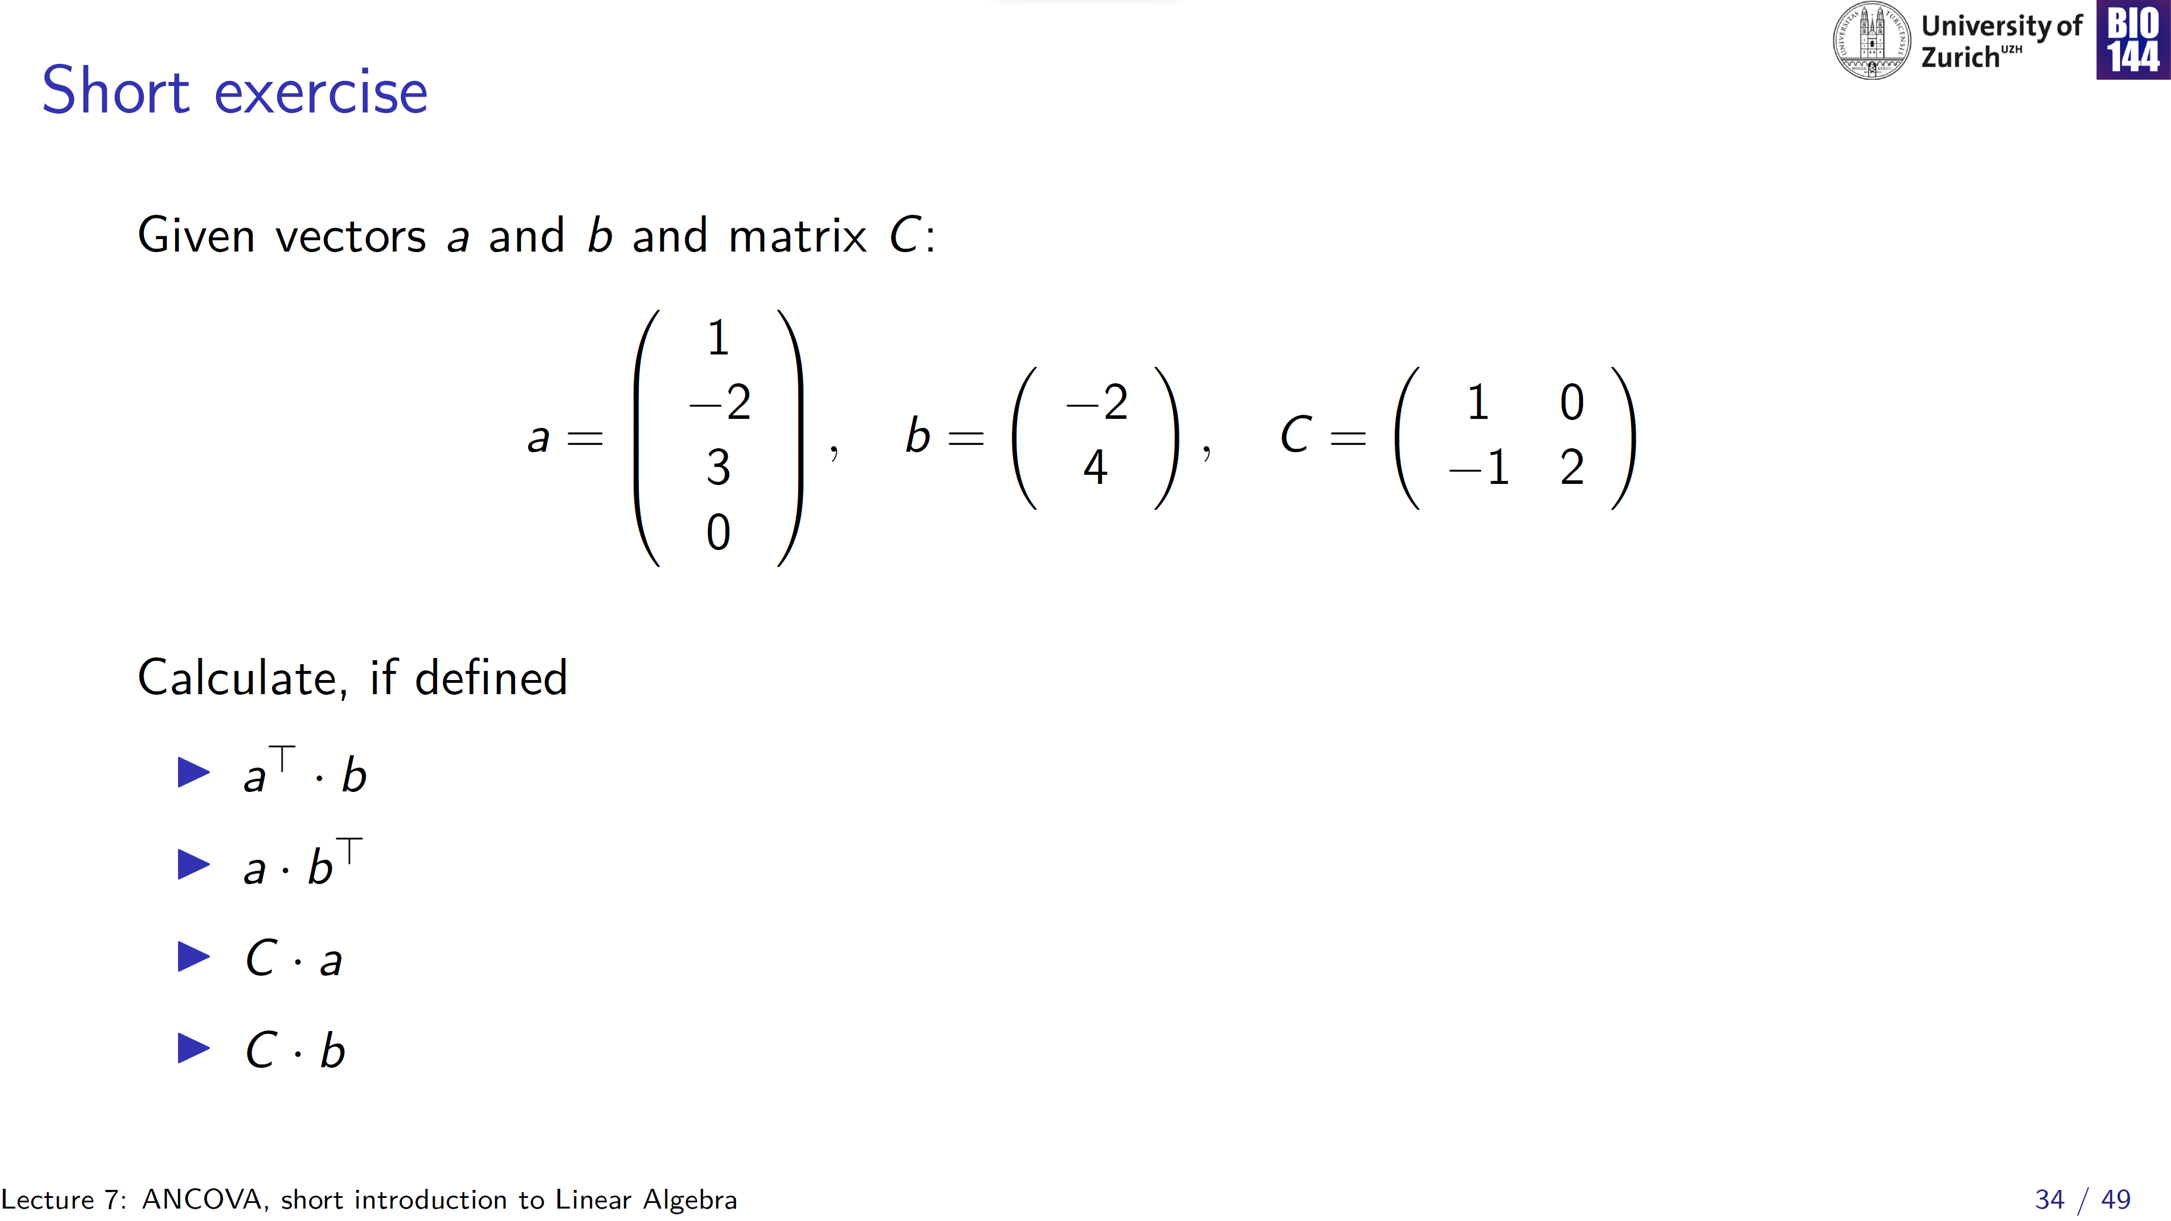
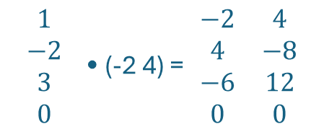
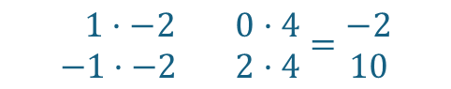
Tip:
[n x m] • [m x p] = [n x p]
[1 x 4] • [2 x 1] → not defined!
$$\begin{matrix}1 \\ −2 \\ 3 \\ 0\end{matrix} \text{•}\text{ (−2 4) = }\begin{matrix}−2 & 4 \\ 4 & −8 \\ −6 & 12 \\ 0 & 0\end{matrix}$$
[4 x 1] • [1 x 2] → [4 x 2]
[2 x 2] • [1 x 4] → not defined!
[2 x 2] • [2 x 1] → [2 x 1]
$$\begin{matrix} 1·−2 & 0·4 \\ −1·−2 & 2·4\end{matrix}=\begin{matrix}−2 \\ 10\end{matrix}$$

Slide 35
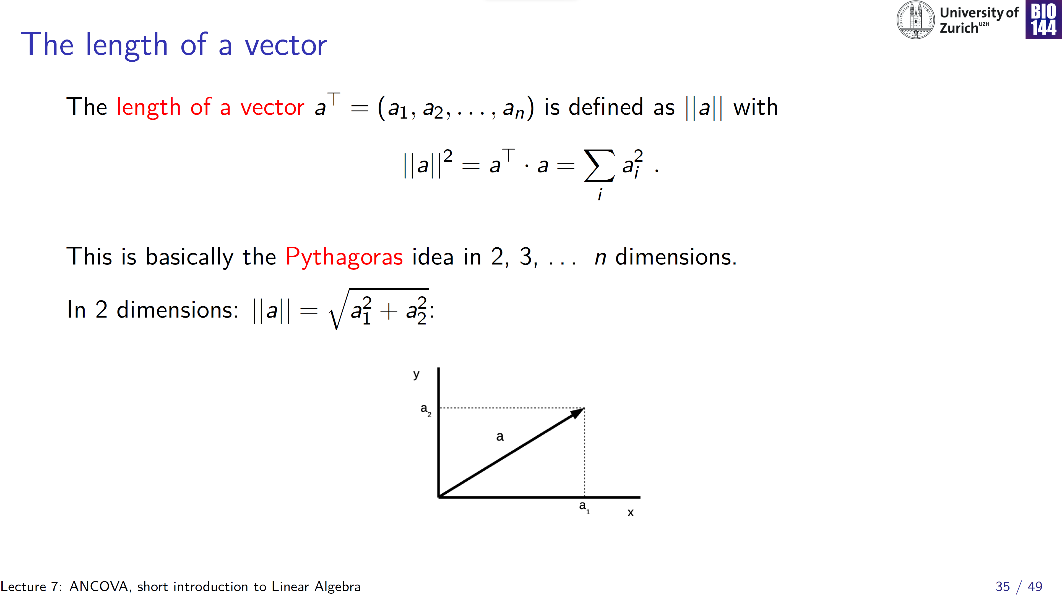
Notes:
||a||= "the norm of vector a" or "the magnitude of vector a“ or "the absolute value of vector a" or "the modulus of vector a"

Slide 36
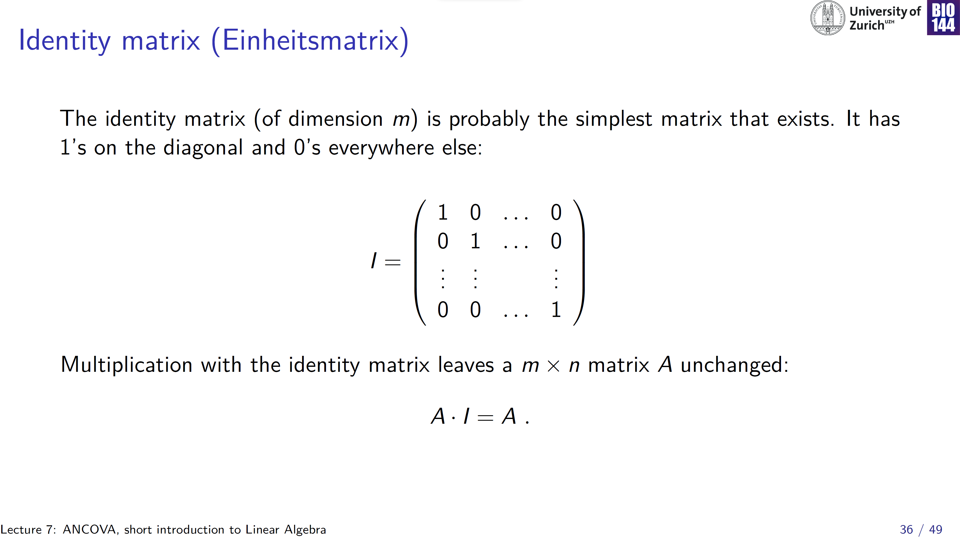

Slide 37
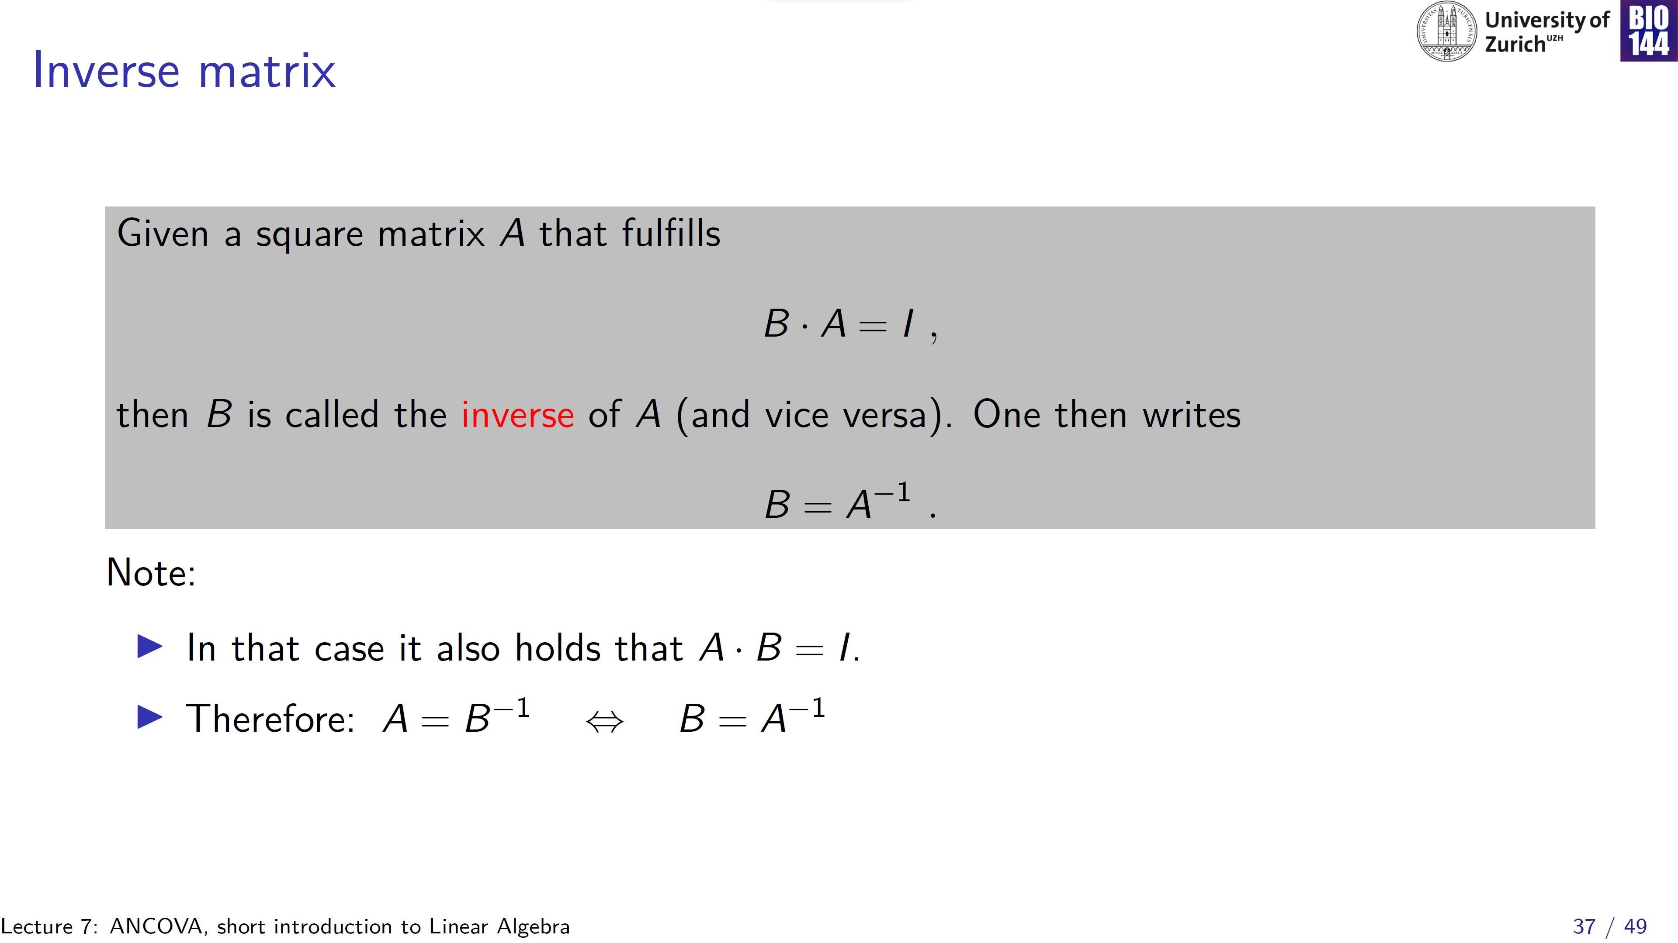

Slide 38
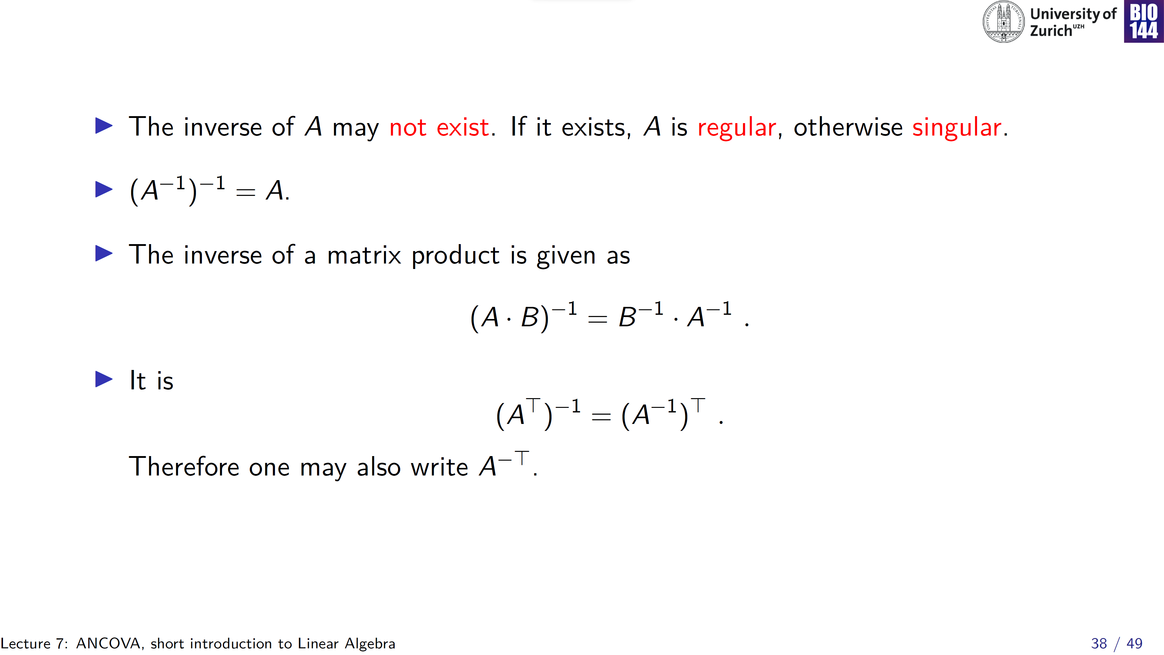

Slide 39
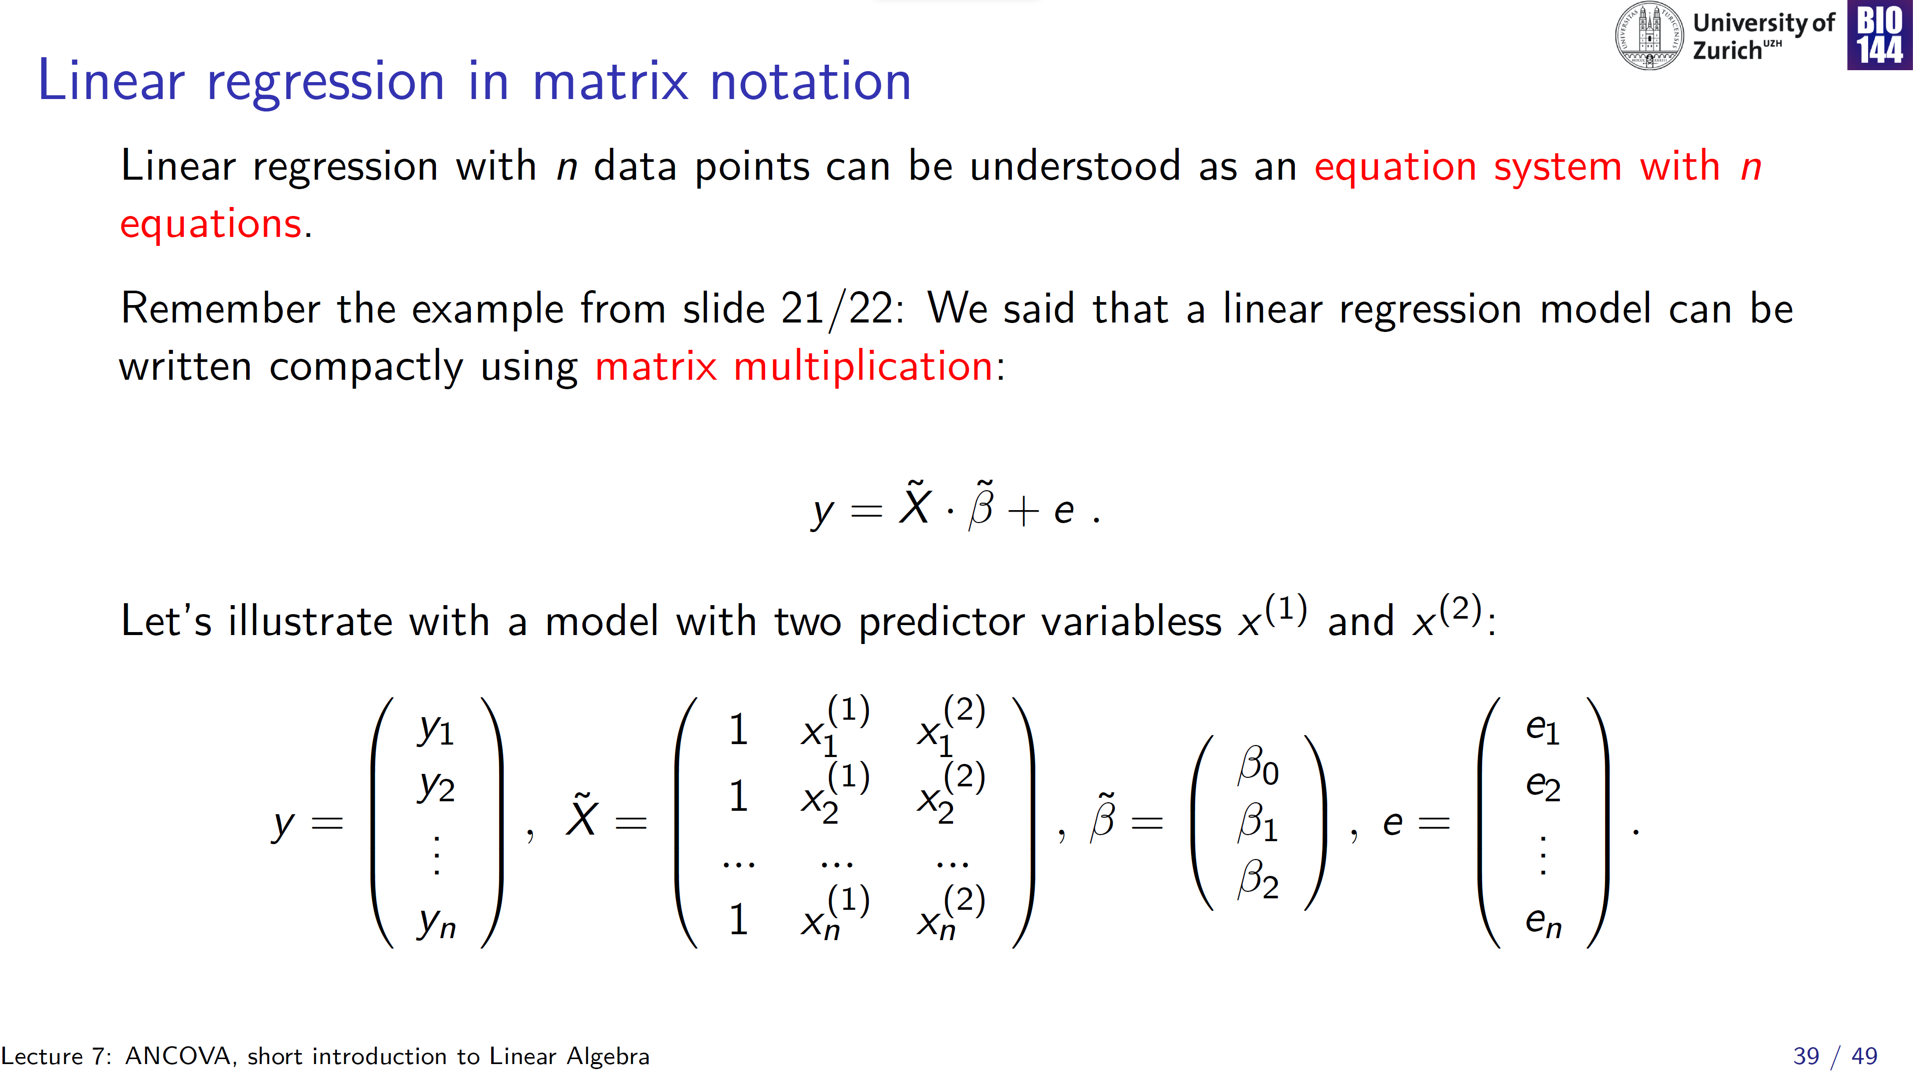
Intercept
Var 1
Var 2

Slide 40
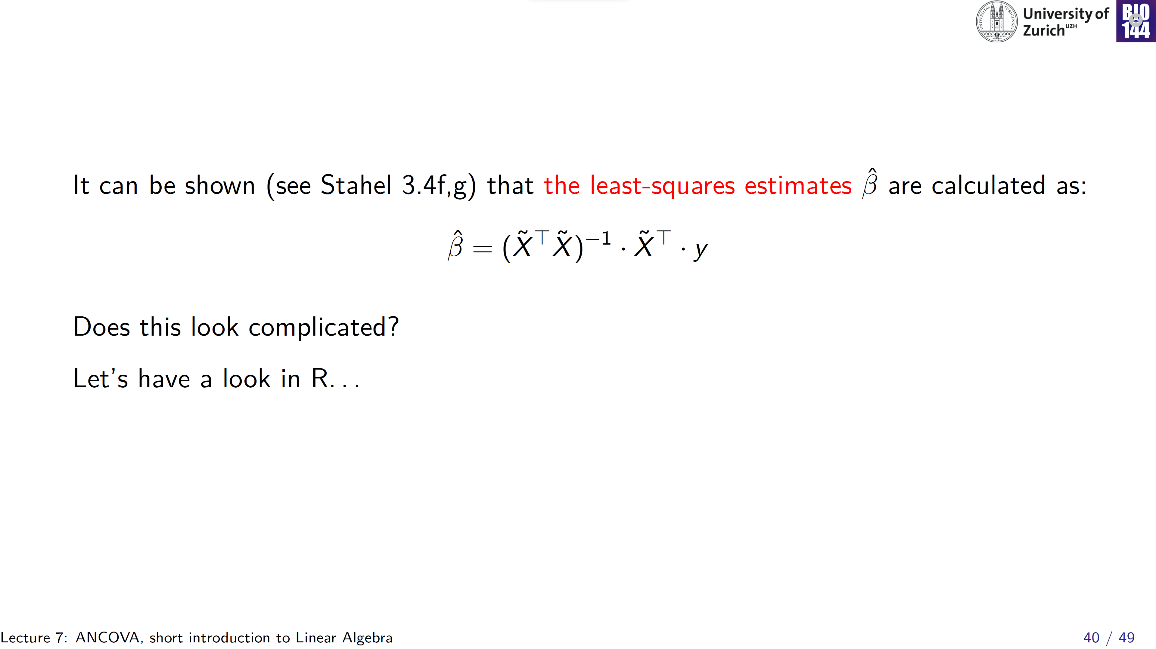
It certainly does to me, but a little practice helps!
Notes:
Also, hopefully if you see something like this in a statistical test that you need to read at some point, you can actually understand what this all entails

Slide 41
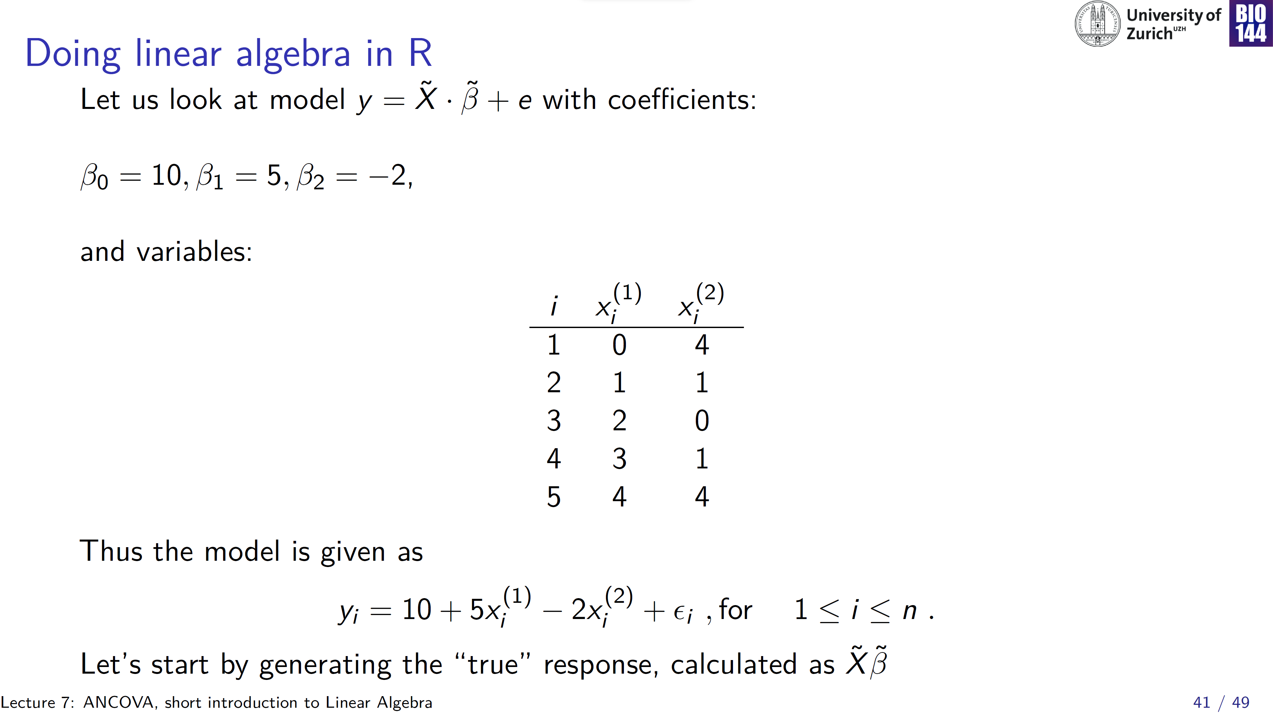

Slide 42
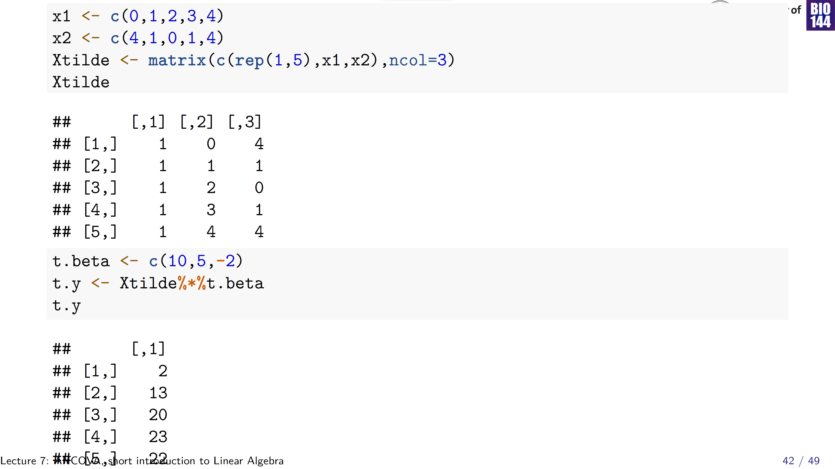

Slide 43
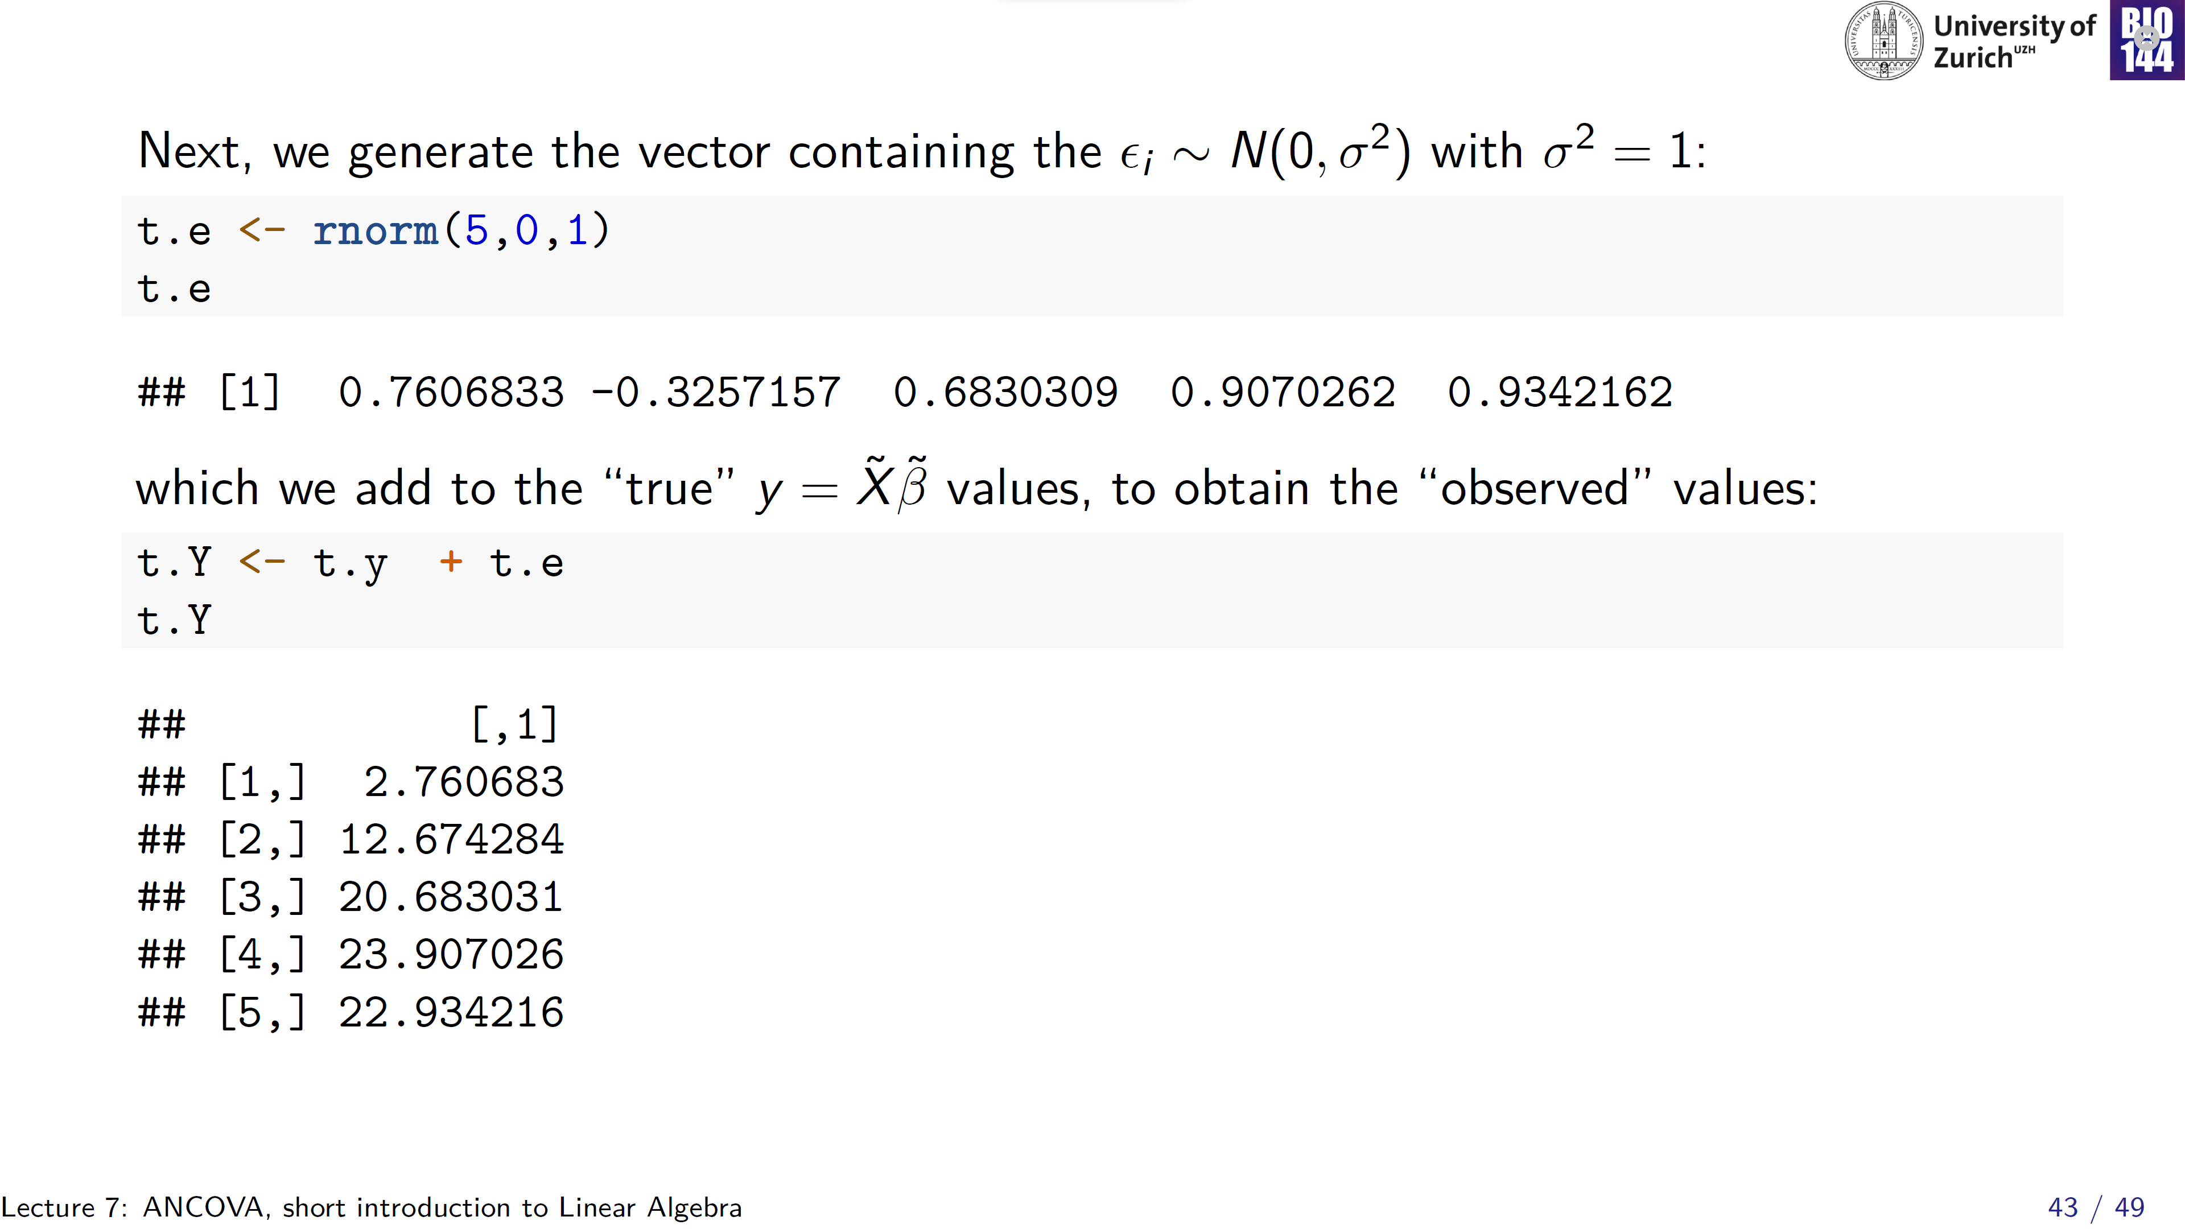

Slide 44
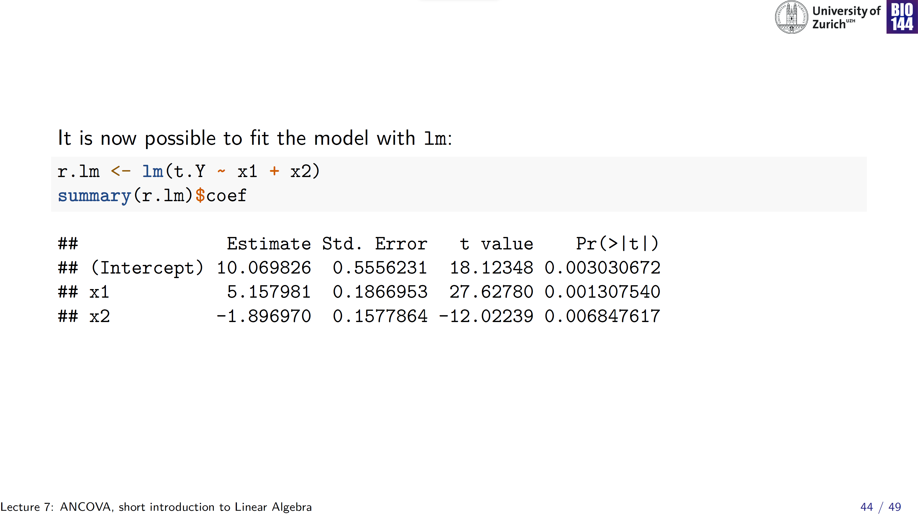

Slide 45
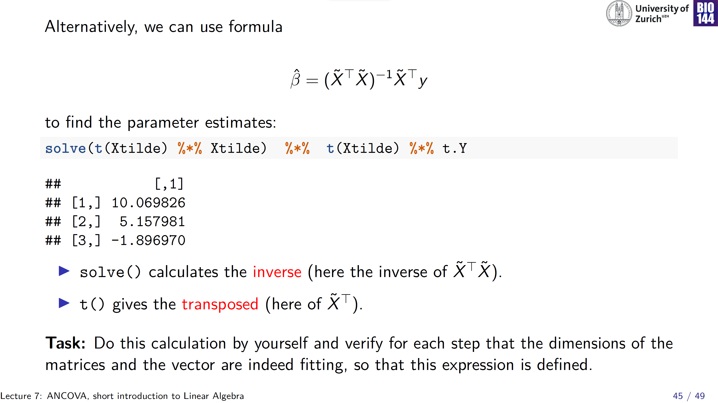

Slide 46
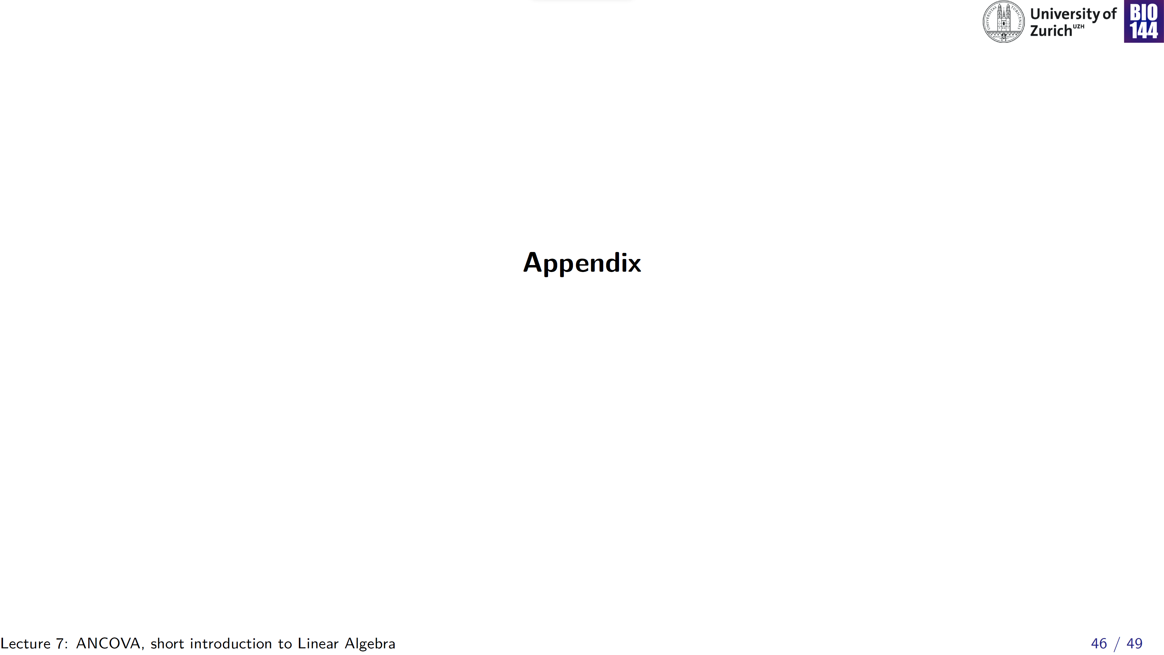

Slide 47
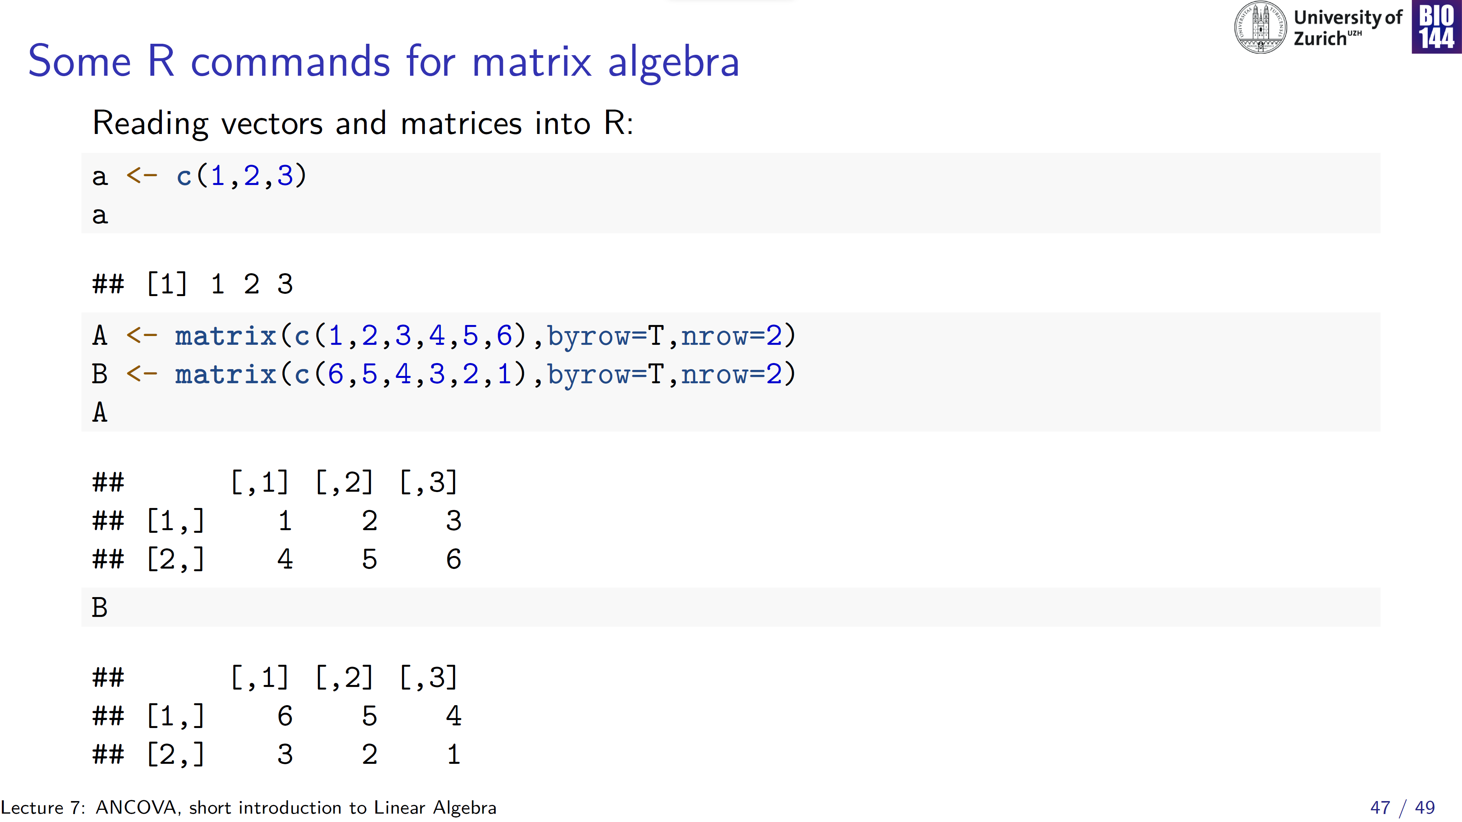

Slide 48
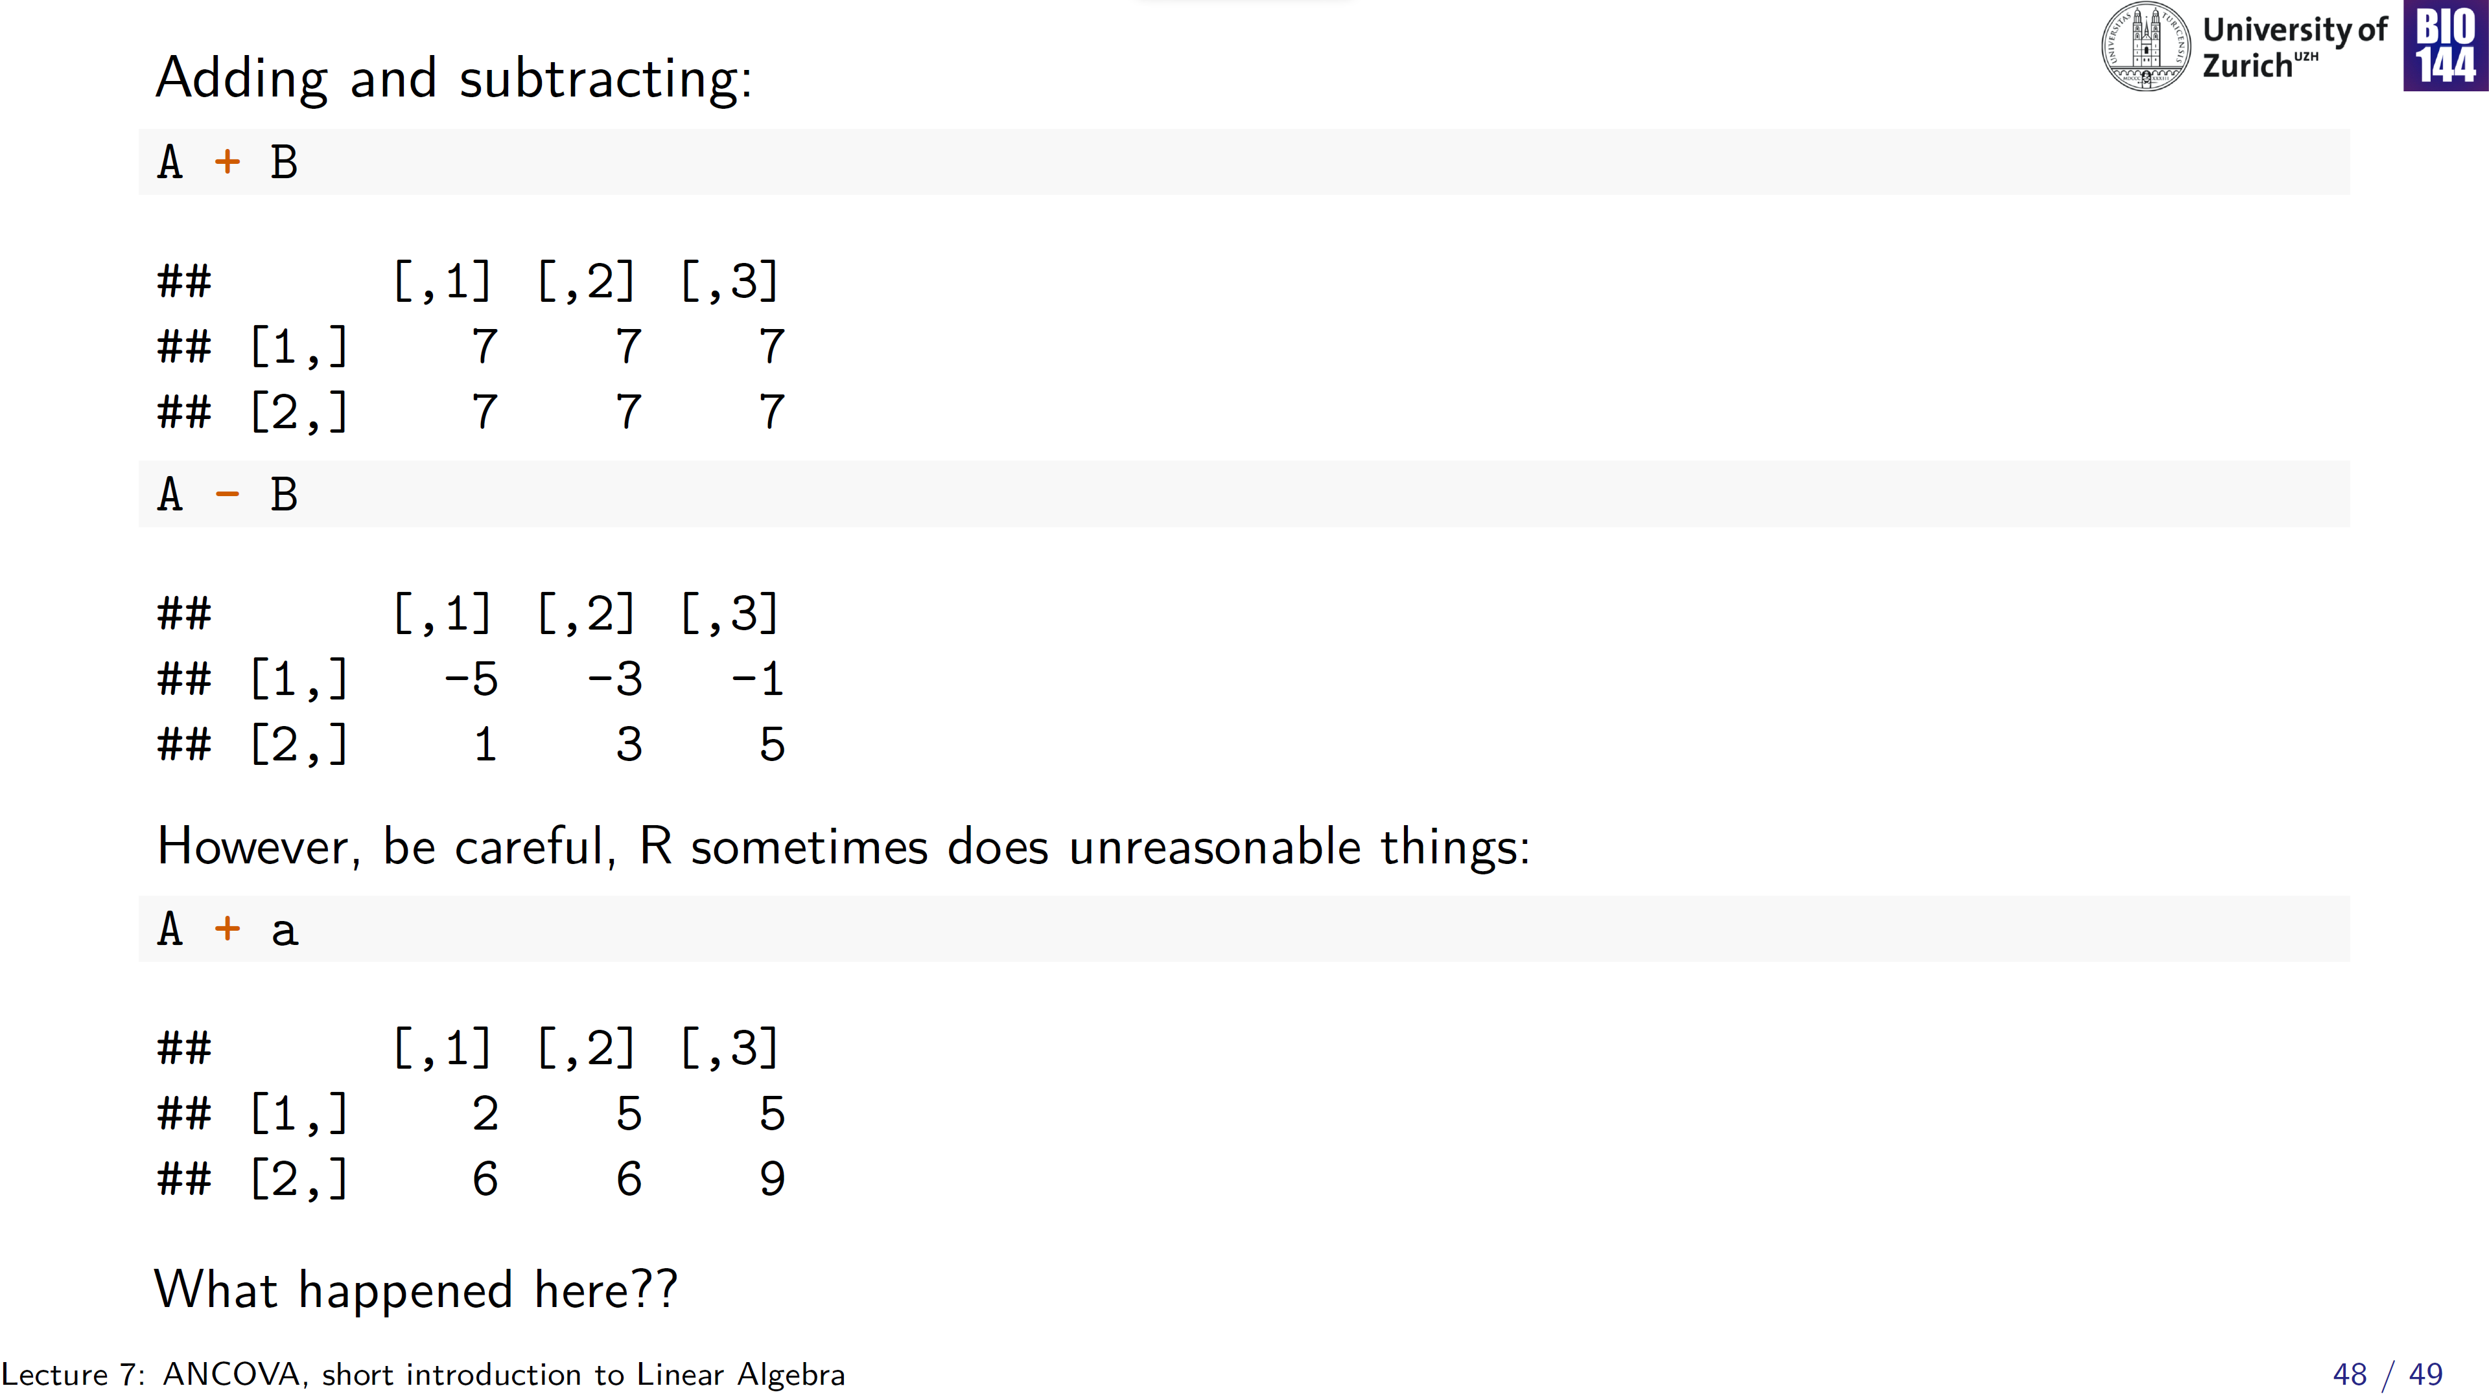

Slide 49


